Slide 1


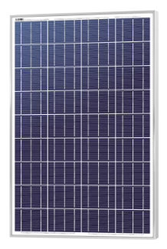
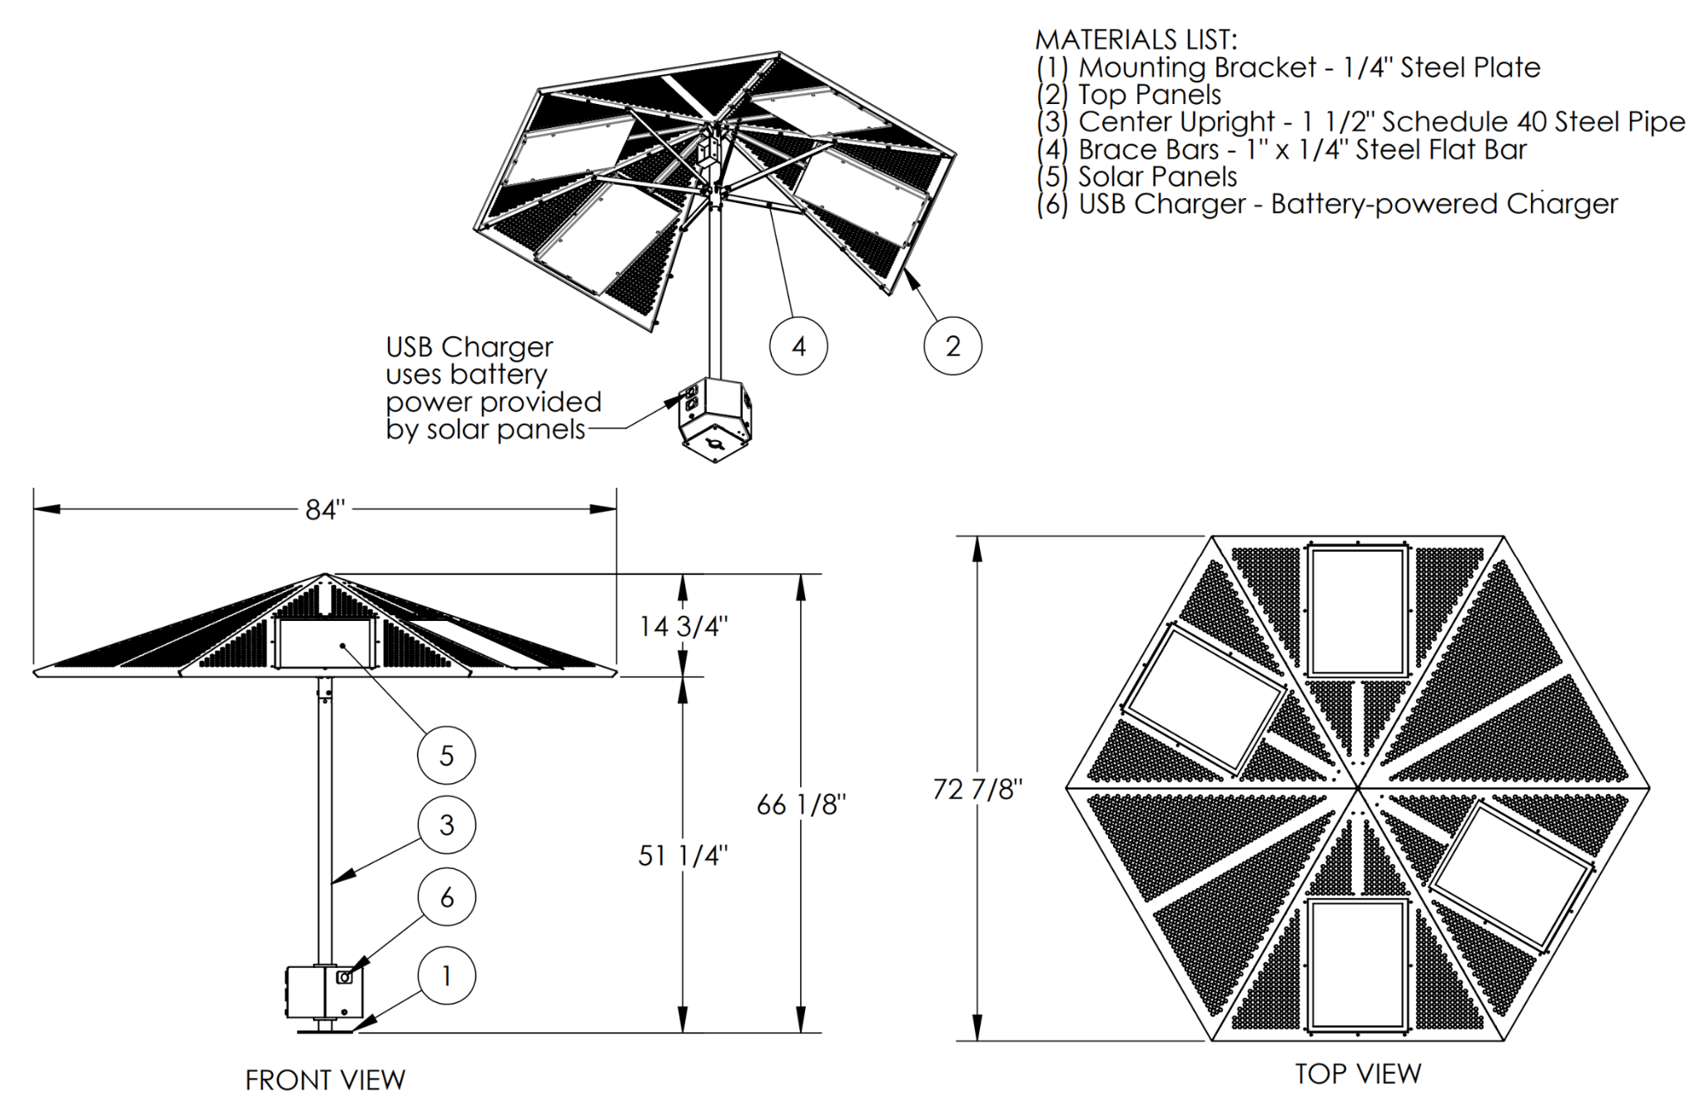
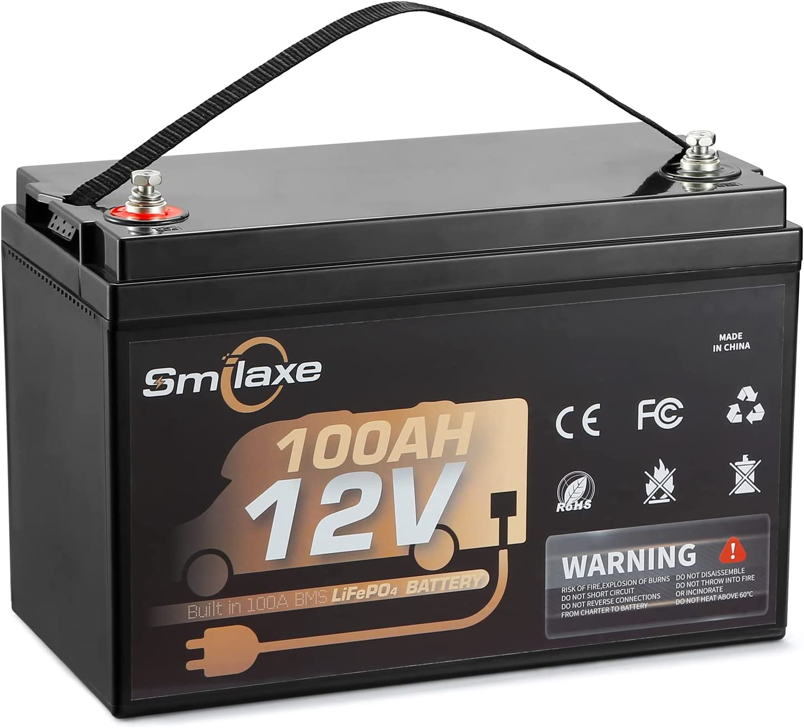
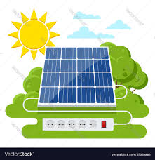
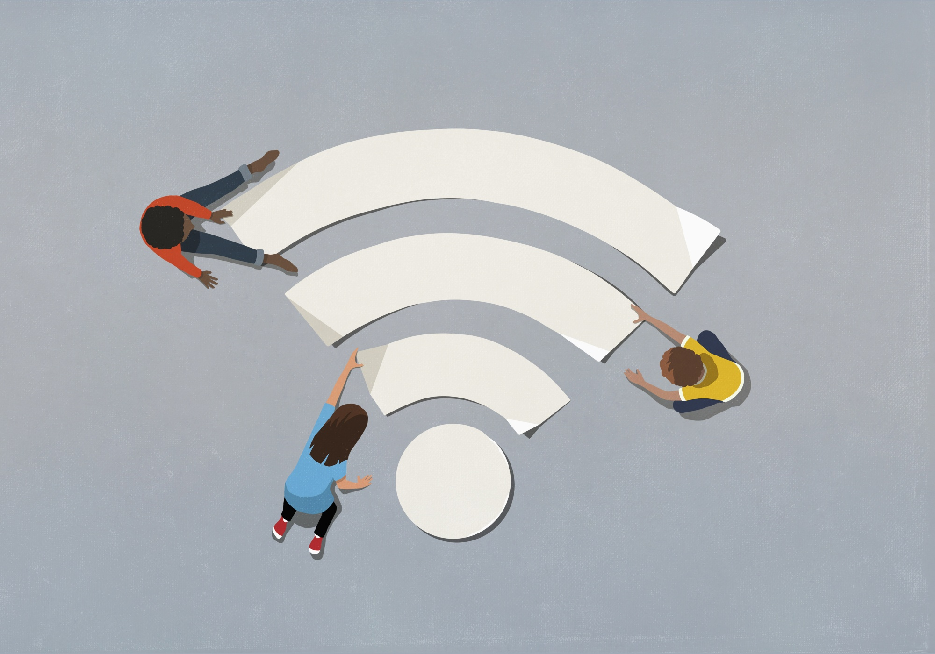
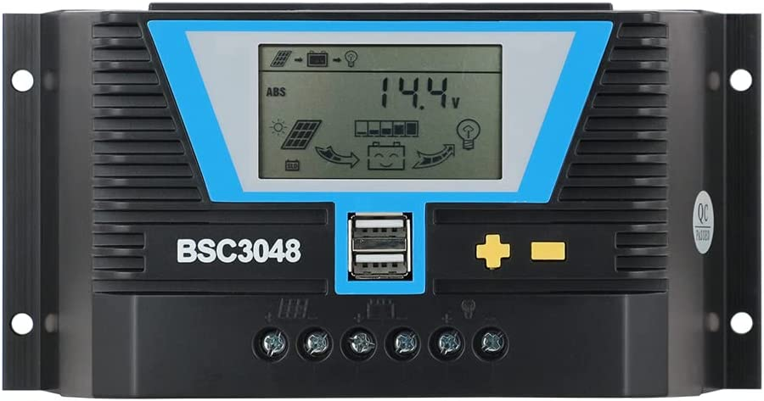
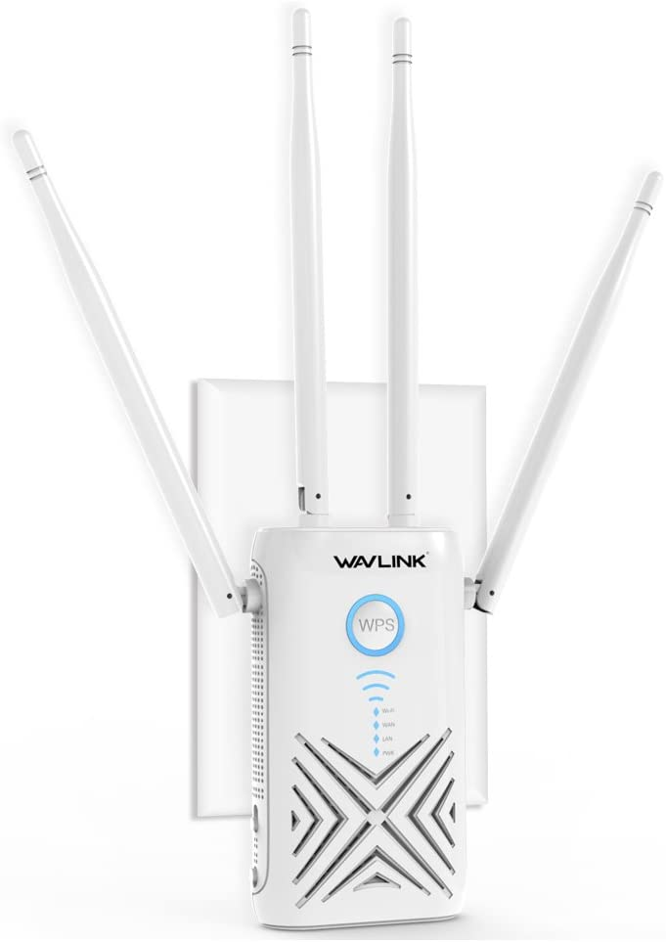
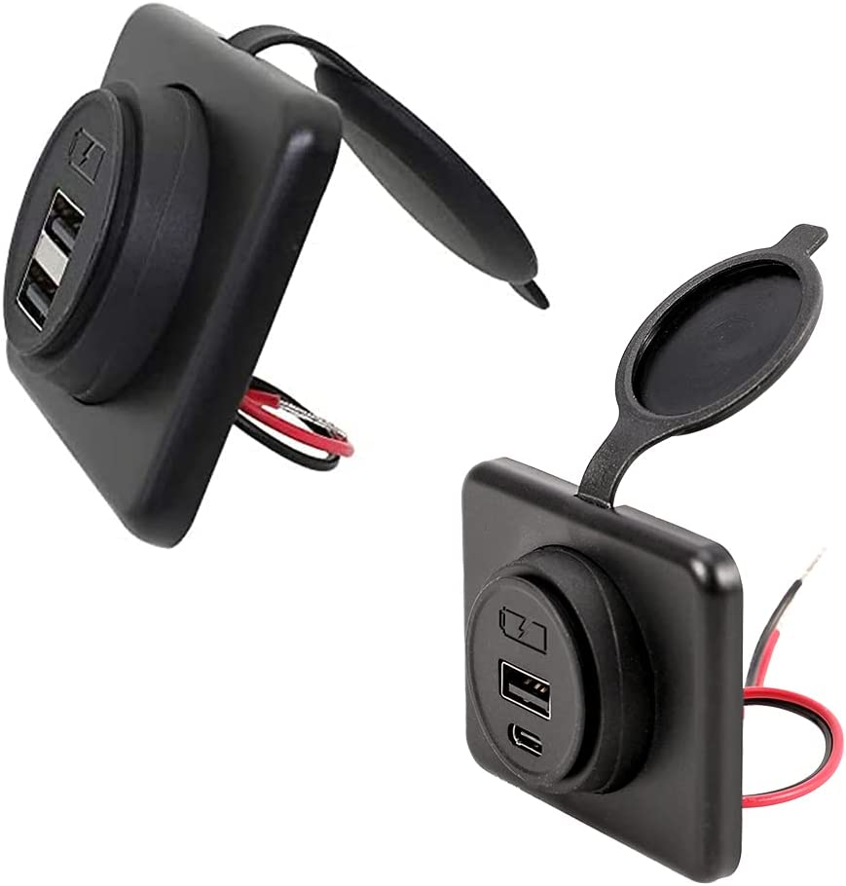
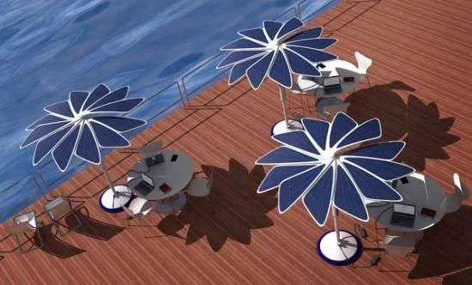

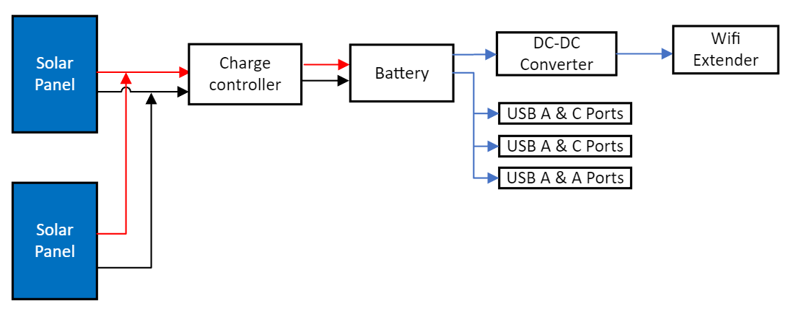
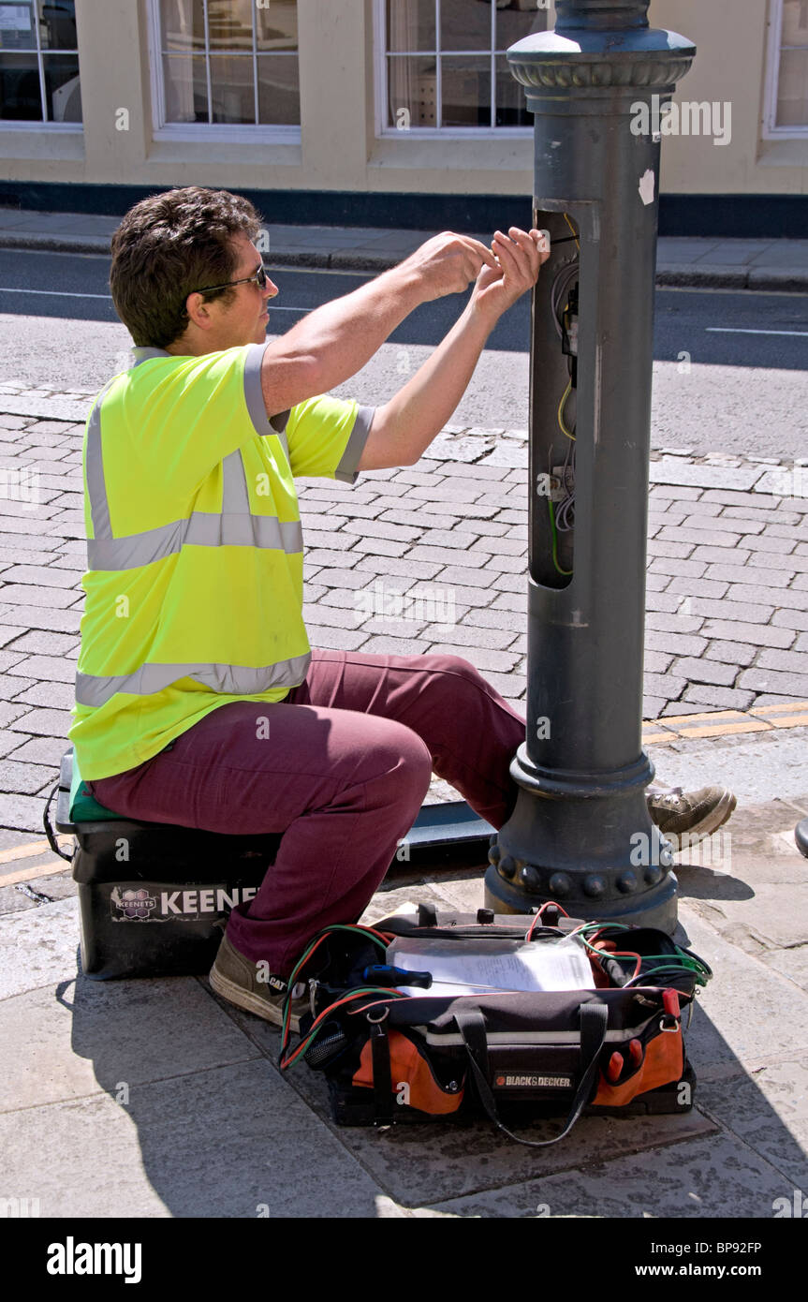
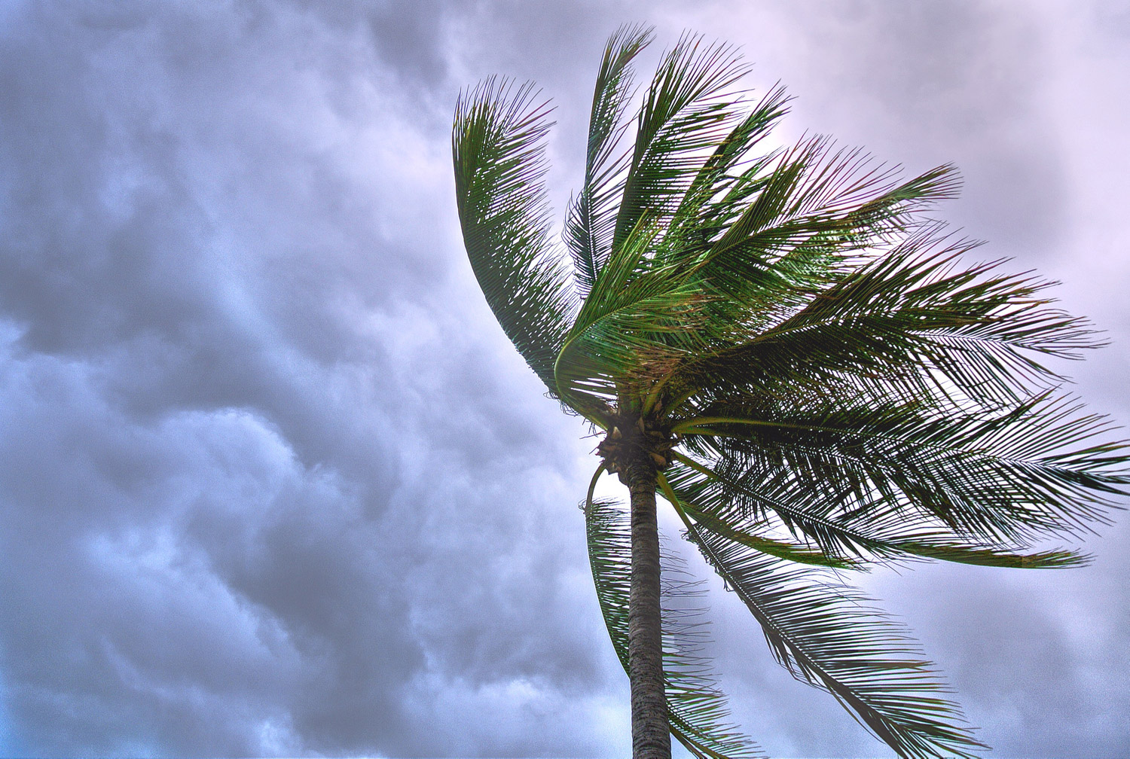
Digital Wi-Fi Canopy
Angel Salges, Alana Brandt, Hetanshu Patel, Victor Perry
Dr. Shonda Bernadin, Dr. Hui Li
Abstract
Design
Component Breakdown
Digital Wi-Fi Canopy is a solar powered umbrella that will be placed at bus stops and parks which will have USB charging ports and Wi-Fi capability. The areas of focus for this project is the Providence neighborhood in Tallahassee, FL. The purpose of this project was to bridge the digital gap in areas that lack internet accessibility. The main requirements for this design are that it is solar powered, Wi-Fi capable, weather resistant, low maintenance, and accessible. Possible markets for this project are transportation companies, park managements, and local governments.
Solar Panels
Two Polycrystalline Solar Panels
Nominal Voltage: 12V
Current: 7.5A
Power: 90W
Parallel connection
Solar Charge Controller
Voltage: 12V
Current Max : 30A
Power Output: 15W
Battery
Type: Lithium Iron Phosphate Battery
Voltage: 12V
Current: 100Ah
Power: 1200Wh
DC-DC Converter
Input Voltage: 12V
Output Voltage: 5V
Current Output: 3A
Power Output: 15W
Wi-Fi Extender
Voltage: 5V
Current: 2.5A
Power: 12.5W
USB-A and USB-C Ports
Voltage: 12V
Current: 2.1A
Power: 25.2W
Main Goals
Use Solar Energy
Aesthetically Pleasing Shelters
Low Maintenance
Reduce the Digital Gap
Convenience for Users
Weather Resistant
Figure 1. Example Design
Figure 1 shows an example design that is used to base the final Wi-Fi canopy structure. The final design of the canopy will only include two solar panels and a wifi extender.
Future Work
Future work will include building, testing, and possible upgrades. Building will involve soldering the components such as wiring the solar panels to the charge controller and then to the battery. Removing the AC to DC converter from the Wi-Fi Extender inorder for the extender to work on DC power.
Testing will include Wi-Fi functionality and ports charging capability. In addition, testing will be performed on the battery charge duration and output power of the solar panels.
Possible upgrades to the canopy could be a fan, lights, heater and a display for bus timings.
Figure 2. Block Diagram

