Slide 1

Senior Design Team 312:
Digital Wi-Fi Canopy
EEL- 4911C
October 21, 2022

Slide 2
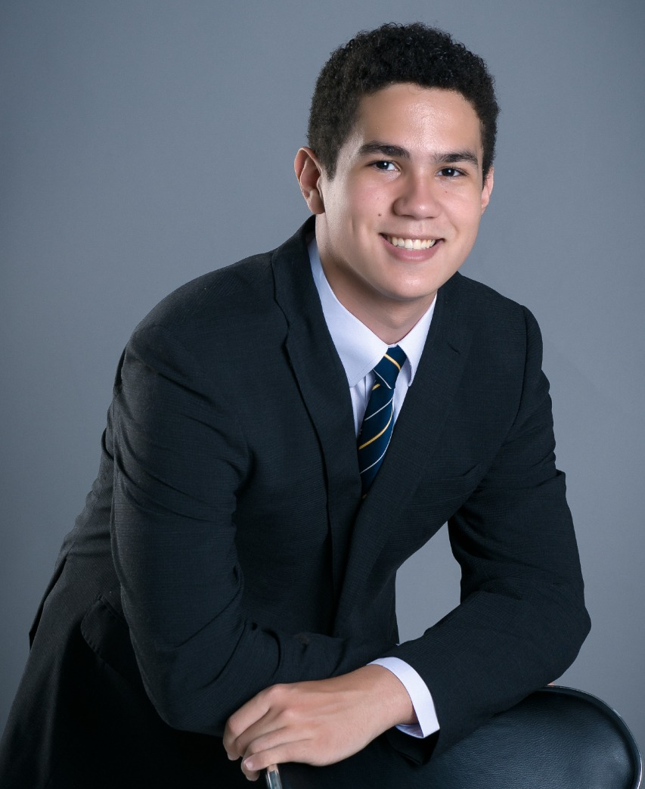
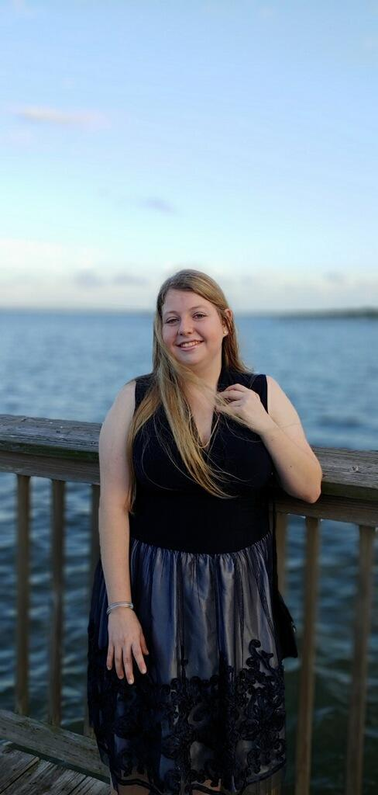

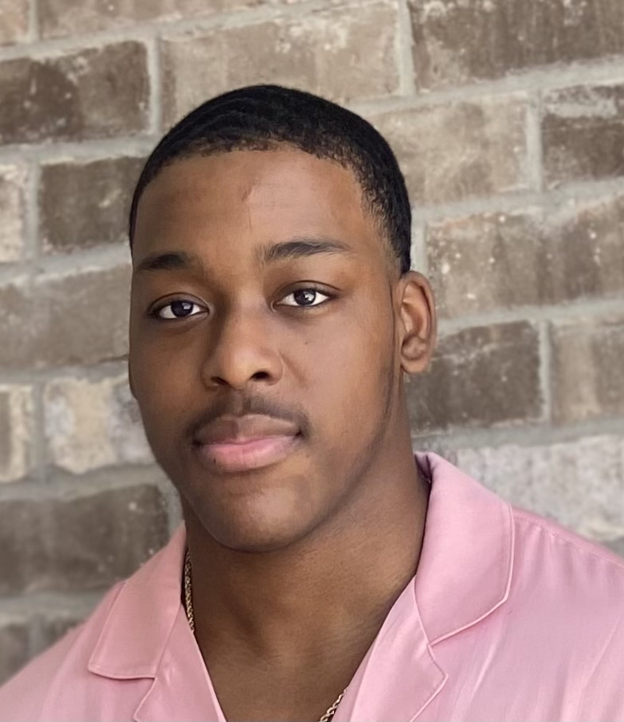
Team Introductions
Angel Salges
Team Leader
Alana Brandt
Lead Electrical Engineer
Hetanshu Patel
Software & Hardware Integration
Victor Perry
Test & Development
Engineer

Slide 3

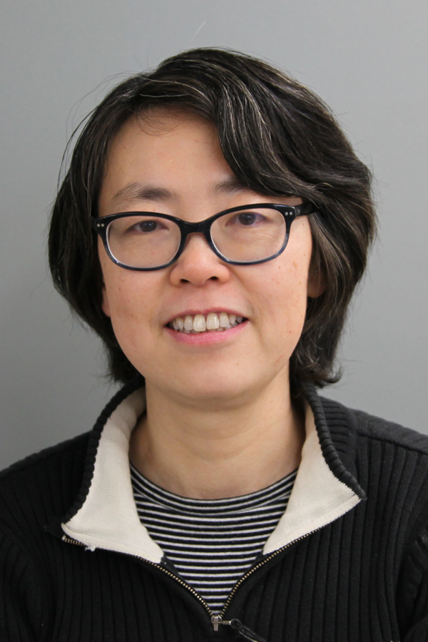

Advisor
Sponsors
Dr. Hui Li

Slide 4
Outline
Project Background
Project Scope
Customer Needs
Project Plan
Functional Decomposition
Summary

Slide 5



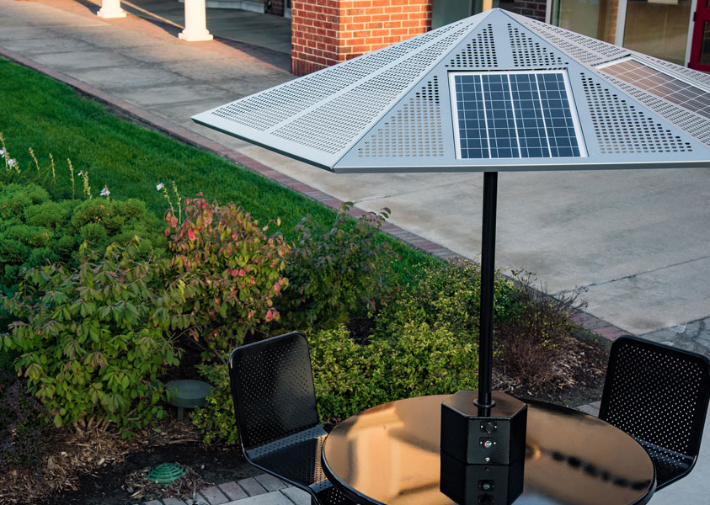
Project Background
Presenter: Hetanshu Patel
Project proposed by:
  TI Instruments
Initial Idea:
  Provide power and wifi to users in park/bus stops
Next Step:
  Research and Propose
Goal
  Make the umbrella movable, as well as efficient

Slide 6
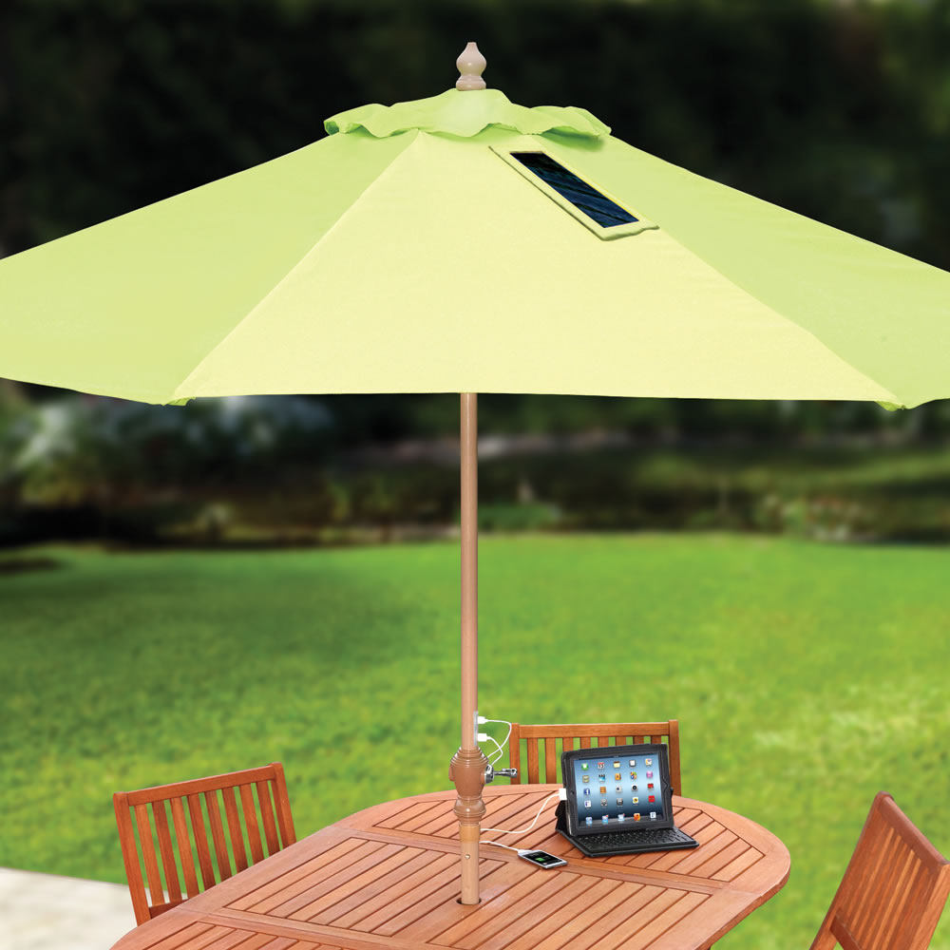
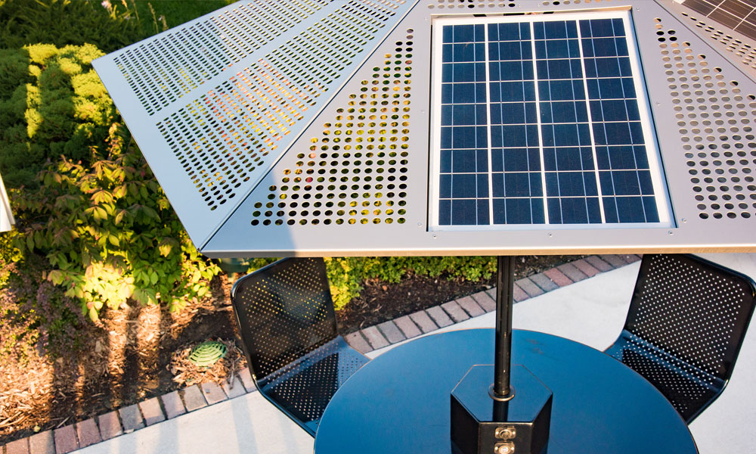
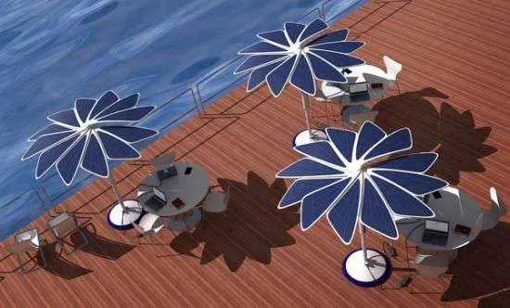
Project Background
Presenter: Hetanshu Patel
Digital Wifi Canopy
  It is solar powered umbrella that will provide charging ports and wifi for near by pedestrians
Current Technology
  Green Head, Bluu Maple, Sunbolt

Slide 7
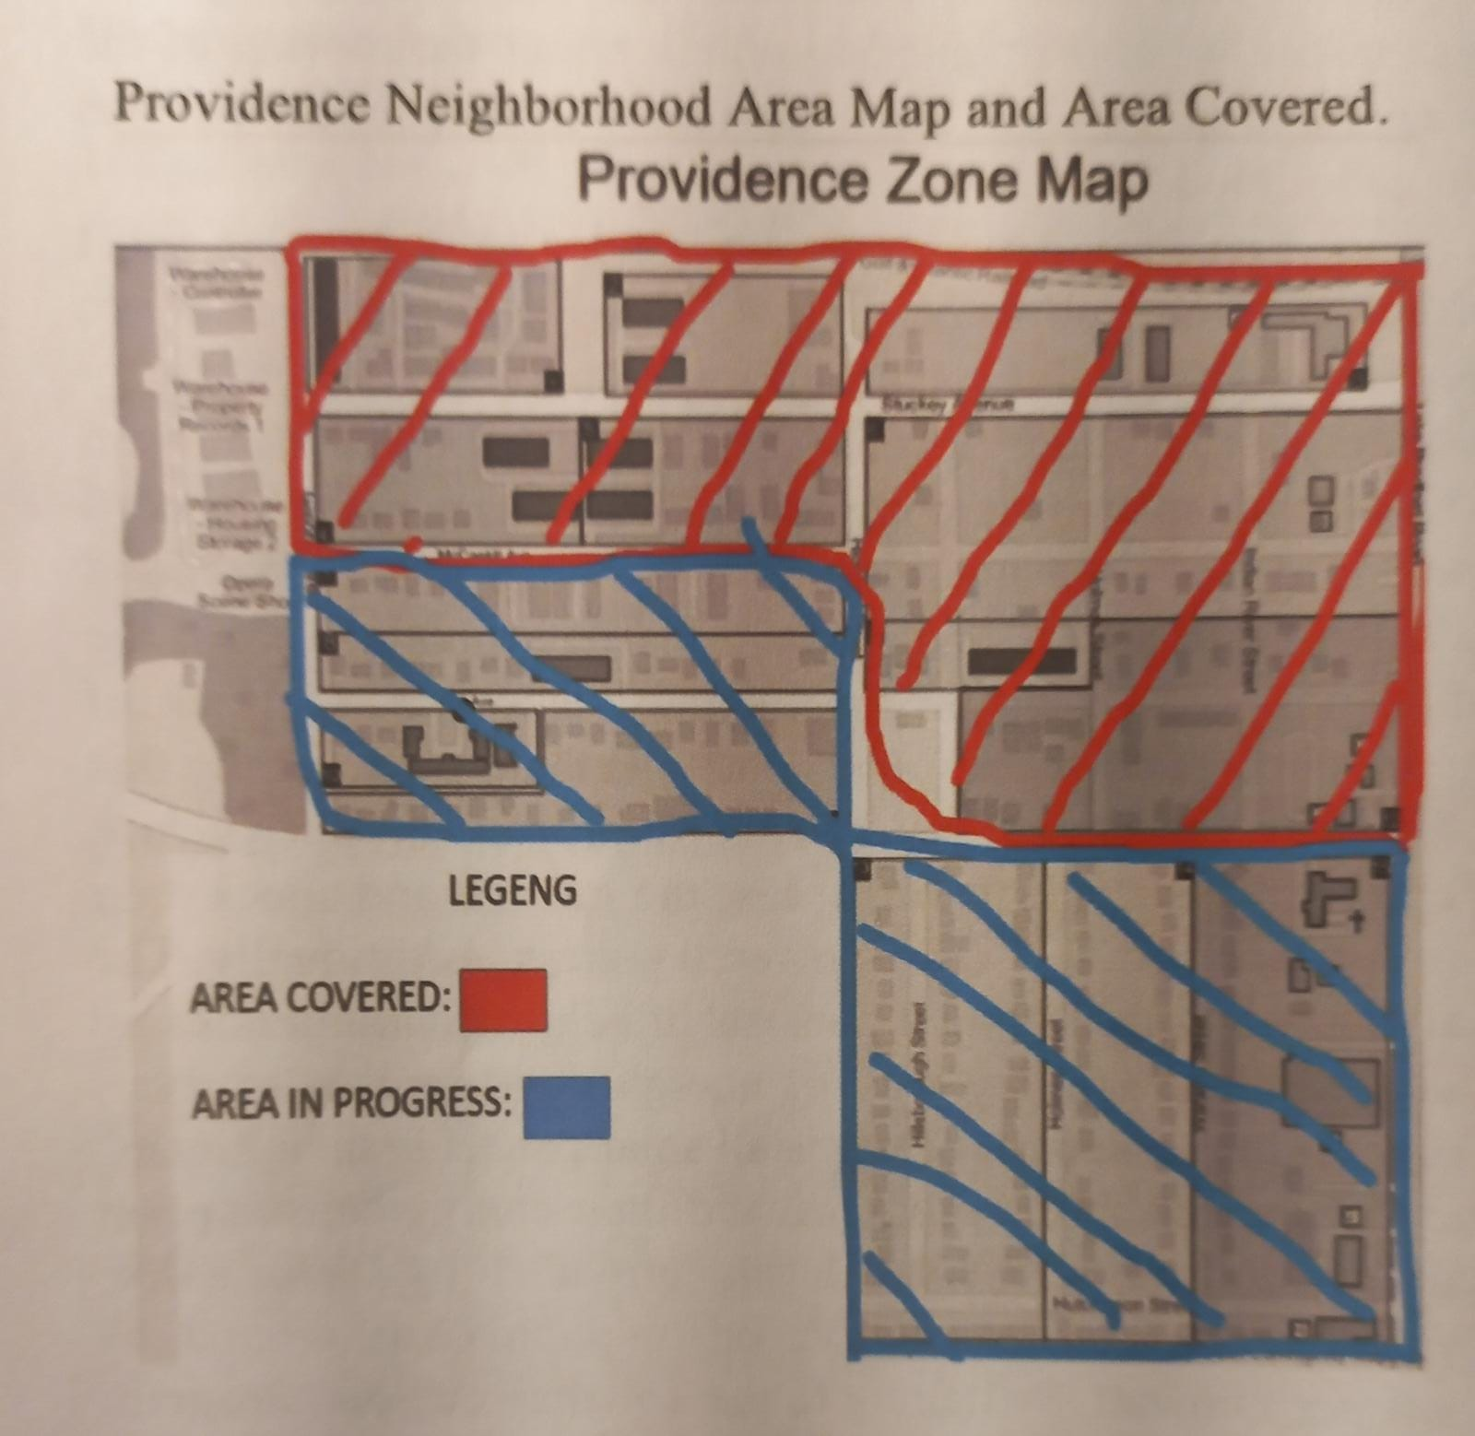
Project Background
Presenter: Hetanshu Patel
Motivation
  Provide power to charge devices and wifi to people who use public transport and amenities

Slide 8
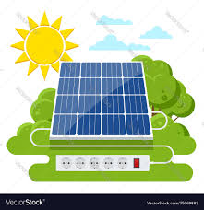

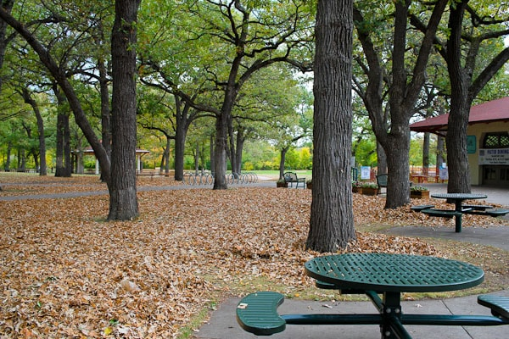
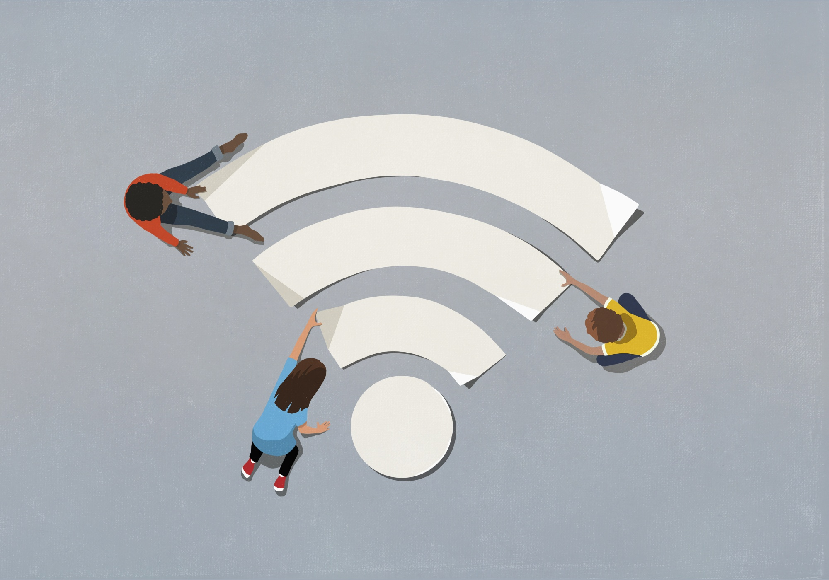
Project Scope
Presenter: Angel Salges
Goals:
Use renewable energy
Aesthetically pleasing shelters
Convenience for users
Reduce the digital gap
Description: Develop shelters, such as park tables and bus stops, that provide charging stations, shade from the sun, and wifi connection using solar panels. Design should be low maintenance, weather resistant, and accessible to multiple individuals at a time.

Slide 9



Project Scope
Presenter: Angel Salges
Markets:
Primary: Transportation Companies,Park managements, Local Governments
Secondary:Restaurants, Individuals
Assumptions:
Will function with solar energy
Is be able to be carried by people
Is modular (able to receive additional amenities without rebuilding)

Slide 10
Customer Needs
Presenter: Alana Brandt
Provides Power
Provides Wifi and Charging Station
Durable
Movable
Maintainable
Reliable
Presenter: Alana Brandt

Slide 11
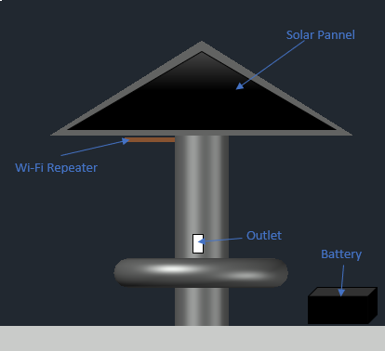
Customer Needs
Presenter: Alana Brandt
Solar Powered
Charge up to 5 small devices
Provide wifi for a small area
Store power using a battery
Durable against mild weather
Movable

Slide 12
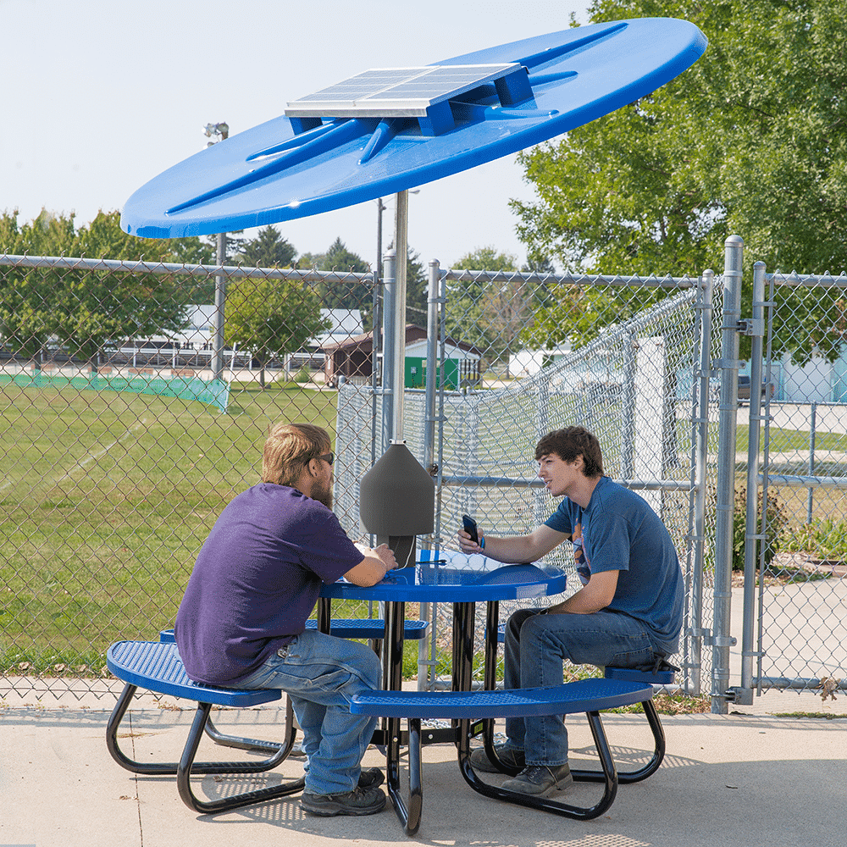
Project Plan
Presenter: Hetanshu Patel
The digital wifi canopy will provide power to charge users electronics and the wifi repeater at the same time
The canopy will be sturdy enough to sustain mild weather but will also be able to disassemble if the weather becomes worse
Our goal is to make an umbrella that uses solar power as a source in order to provide electricity for its users

Slide 13
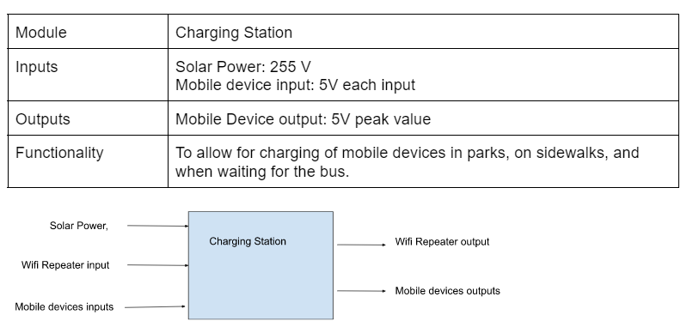
Functional Decomposition
Presenter: Victor Perry
Level 0
Notes:
Victor- 3 main functions Level 0 is the charging station w its inputs and outputs

Slide 14
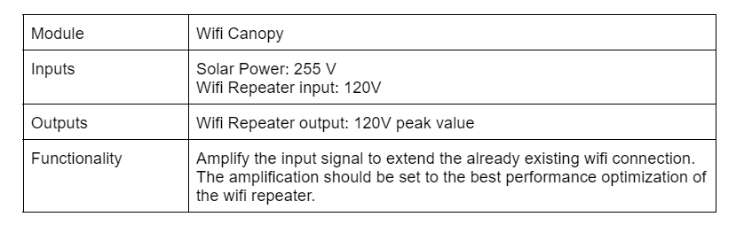
Functional Decomposition
Presenter: Victor Perry
Level 1
Notes:
Victor - level 1 breakdown of wifi repeater

Slide 15
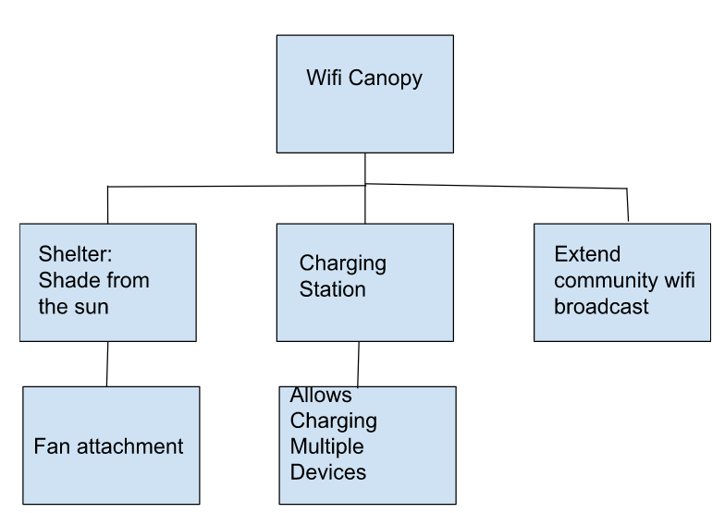
Functional Decomposition
Presenter: Victor Perry
Notes:
Victor- our function tree which displays the basic concept of the wifi canopy

Slide 16
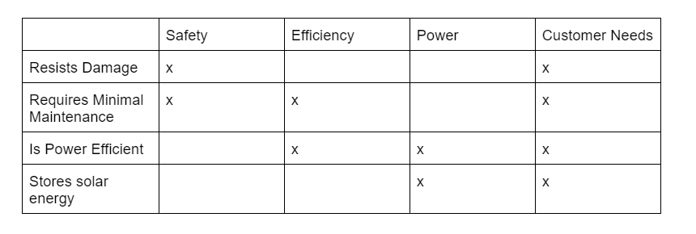
Functional Decomposition
Presenter: Victor Perry
Cross-Reference Table
Notes:
Victor- cross reference table based on our design requirements

Slide 17
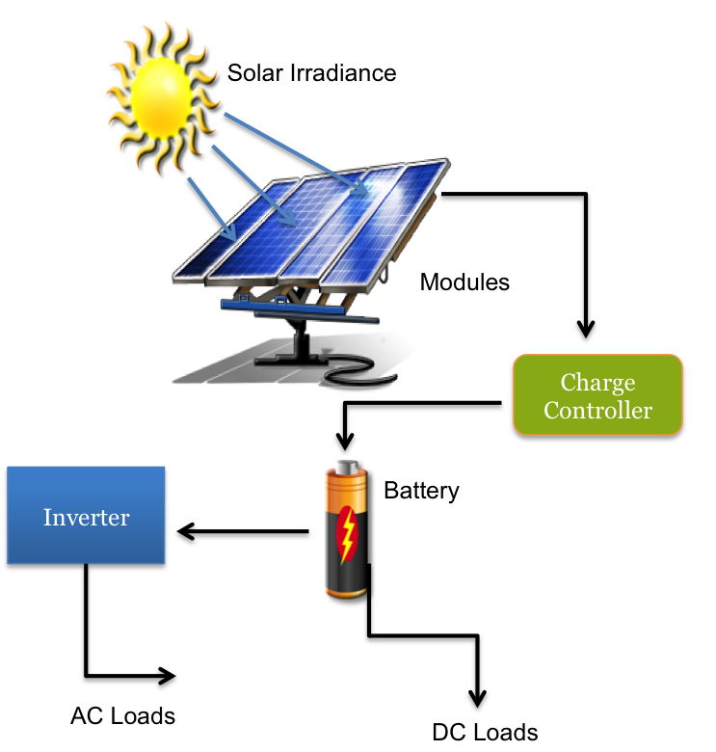
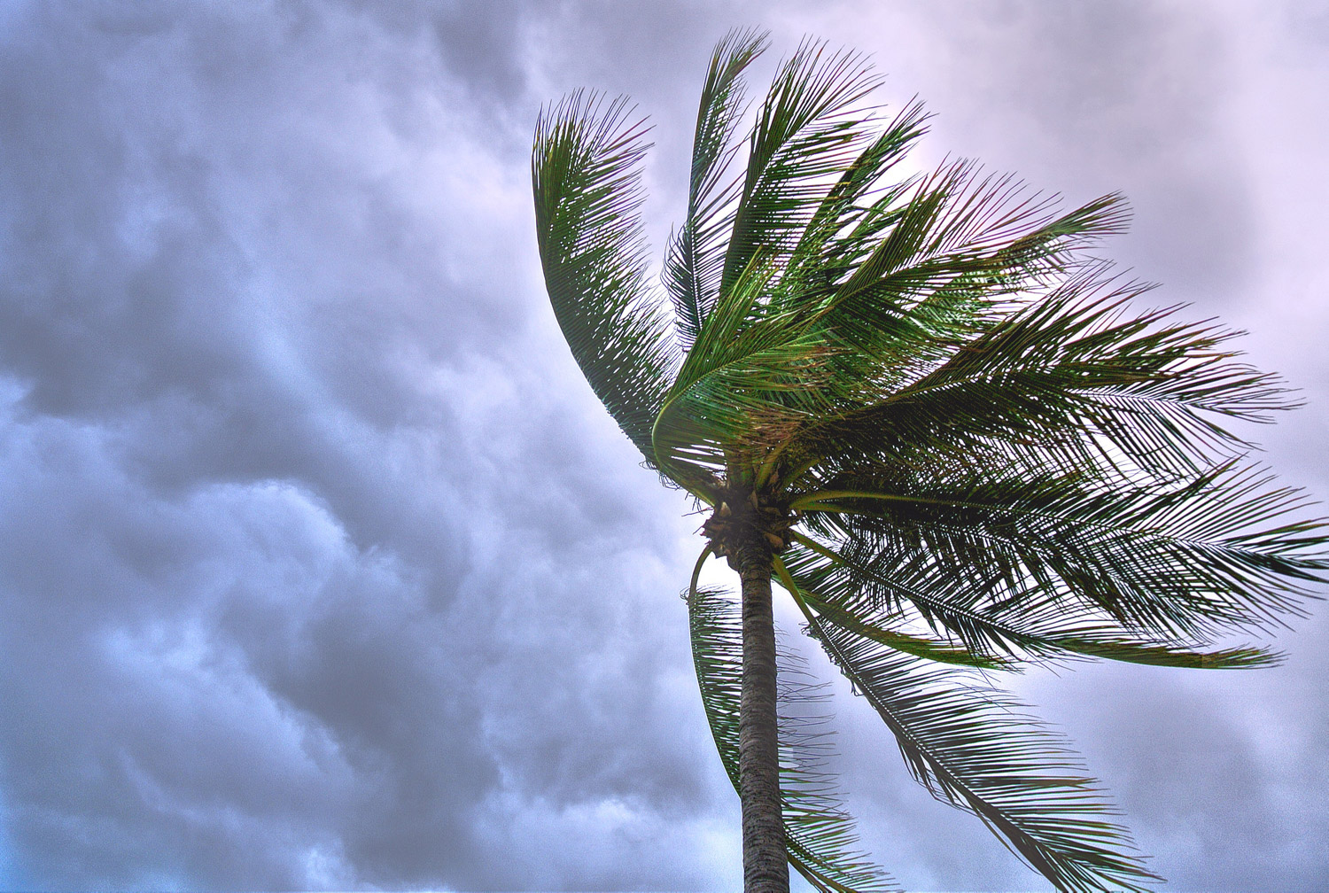
Target Summary
Presenter: Angel Salges
Uses solar energy to charge devices: Critical
This target is essential to the project. This is the primary purpose of building the device. Metric is binary as it only needs to use solar power per customer instructions.
Device will not break under a Hurricane:
This target is important for the safety and well-being of the people and the device. The metric was taken from the requirements of the Florida Building Code. The only limit to resistance would be the cost and not being able to be permanently fixed.

Slide 18

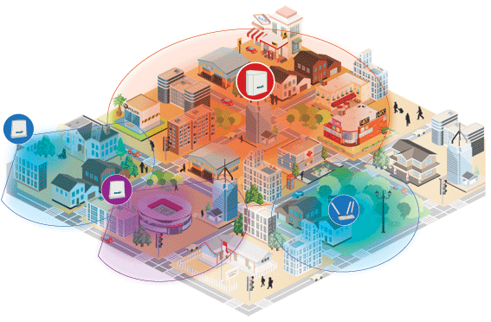
Target Summary
Presenter: Angel Salges
3. Will not be permanently attached:
This target aims to make the device movable to any place that is needed without it being destroyed. This is a goal but can be dismissed if incompatible with the previous target.
4. Provides WiFi to a Small Area:
This target is moderately important as it is a soft requirement and can be adjusted depending on price and power consumption. We will measure the broadcast of the network at different points more than 600m away from the device to see the reach.

Slide 19
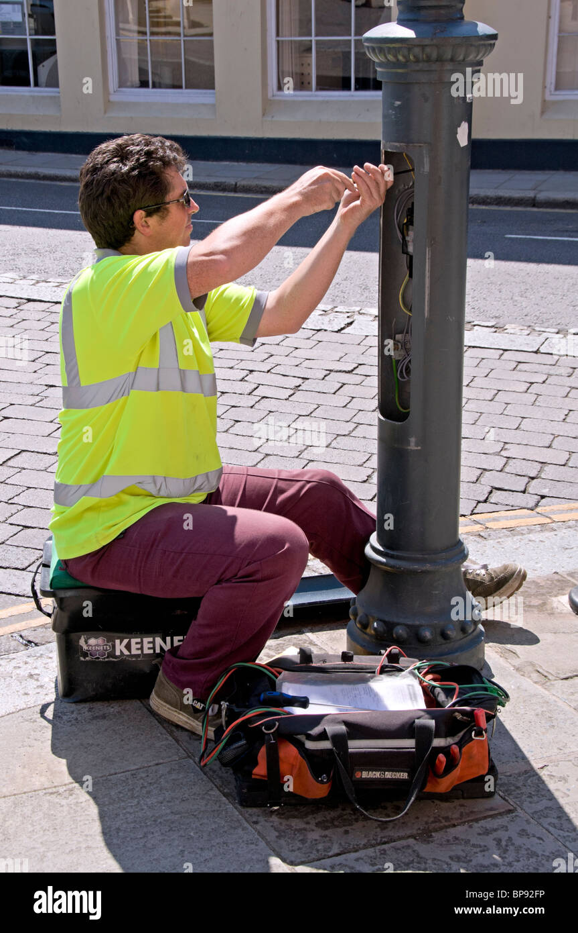

Target Summary
Presenter: Angel Salges
5. Components are accessible and replaceable:
This target aims to facilitate the interchange of pieces and the replacement of faulty equipment in the device. It also helps the long-term goal of modularity in the device. All pieces that need to be replaced at some point should be easily accessible to a crew without complete disassembly.
6. Will use a battery to store power: Critical
This target’s goal is to make the device usable even without constant sun at any given time. The battery should last at least 10 hours.
The battery will be timed from fully charged until total depletion and should be more than 10h.

Slide 20
Presentation Recap
Presenter: Victor Perry
Project Background
- We want to provide a wifi canopy to the local community
Project Scope
- To improve the daily lives of the local community.
Customer Needs/Targets
- To satisfy design requirements, along with being mobile, durable, and reliable
Project Plan
- To use solar power to provide electricity to its users.
Functional Decomposition
- The three main functions of our design is a shelter, charging station, and wifi repeater.
Notes:
victor

Slide 21
References
“USB-Charging Solar Market Umbrella,” The Green Head - Finds Cool New Stuff! https://www.thegreenhead.com/2013/04/usb-charging-solar-market-umbrella.php (accessed Oct. 21, 2022).
“SiteScapes Inc. - Solar Panel Umbrellas,” www.sitescapesonline.com. https://www.sitescapesonline.com/solar-panel-umbrellas.asp (accessed Oct. 21, 2022).
“Solar Charge Station with Fiberglass Umbrella,” Kay Park & Recreation. https://kaypark.com/product/solar-charge-station-with-fiberglass-umbrella/ (accessed Oct. 21, 2022).
“Solar-Powered Umbrellas,” TrendHunter.com. https://www.trendhunter.com/trends/solaris-sun-shade (accessed Oct. 21, 2022).
Notes:
Not this slide will advance on default after 2 seconds. If you would like to change this then go to the transition tab and under timing change the advance slide settings.

Slide 22
Questions

Slide 23
Backup Sildes
Supporting Slides to the content above.

Slide 25
Standard Shapes
Summary Box
Text box 1
Outlined Text Box

Slide 26

Approved Logos

Slide 27
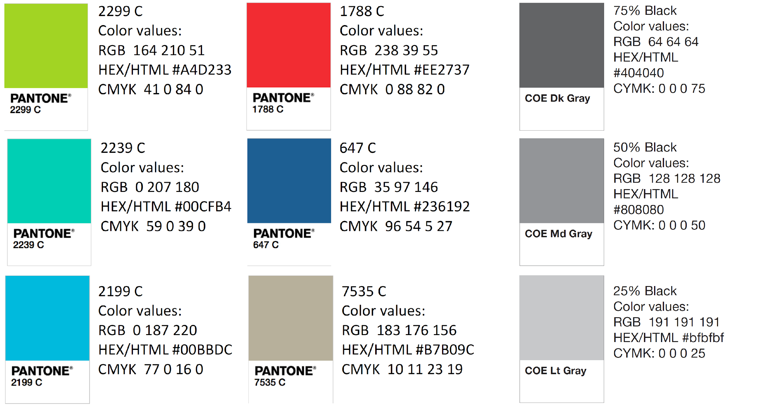
Color Palette

Slide 28
APA Tables
Category 1 | Category 2 | Category 3 | Category 4 | Category 5
Item 1
Item 2
Item 3
Item 4
 | Category 2 |  |  | Category 3
Category 1 | subcategory 1 | subcategory 2 |  | subcategory 1 | subcategory 2
Item 1
Item 2
Item 3
Item 4

