Slide 1

Senior Design Team 312:
Digital Wi-Fi Canopy
EEL- 4911C
November 18, 2022

Slide 2
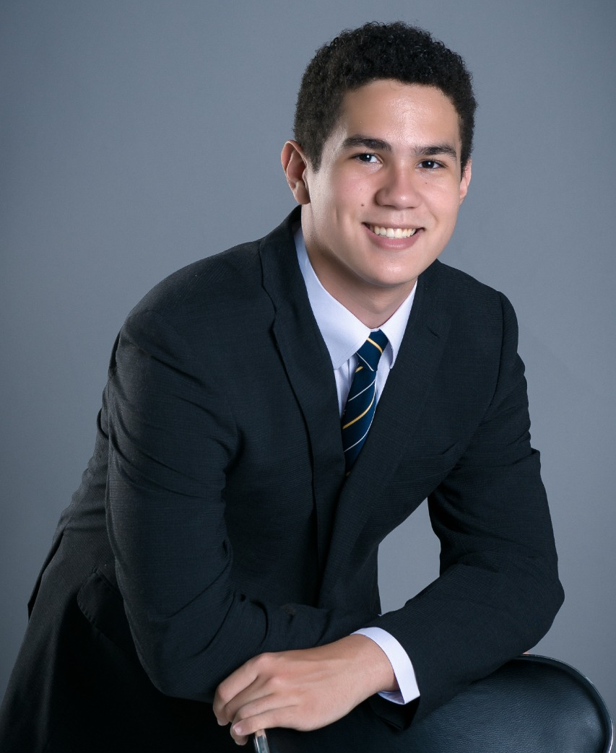


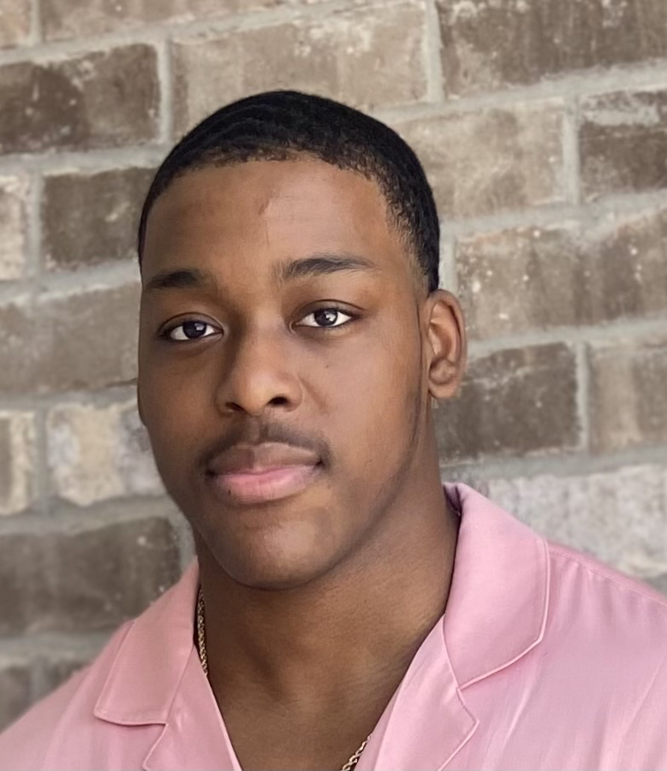
Team
Angel Salges
Team Leader
Alana Brandt
Lead Electrical Engineer
Hetanshu Patel
Software & Hardware Integration
Victor Perry
Test & Development
Engineer

Slide 3



Advisor
Sponsors
Dr. Hui Li

Slide 4
Outline
Review
Targets
Concept Generation & Selection
Bill of Materials
Summary

Slide 5
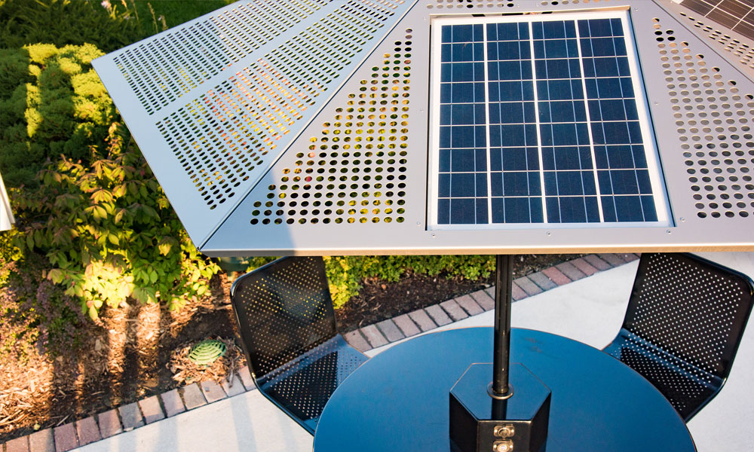
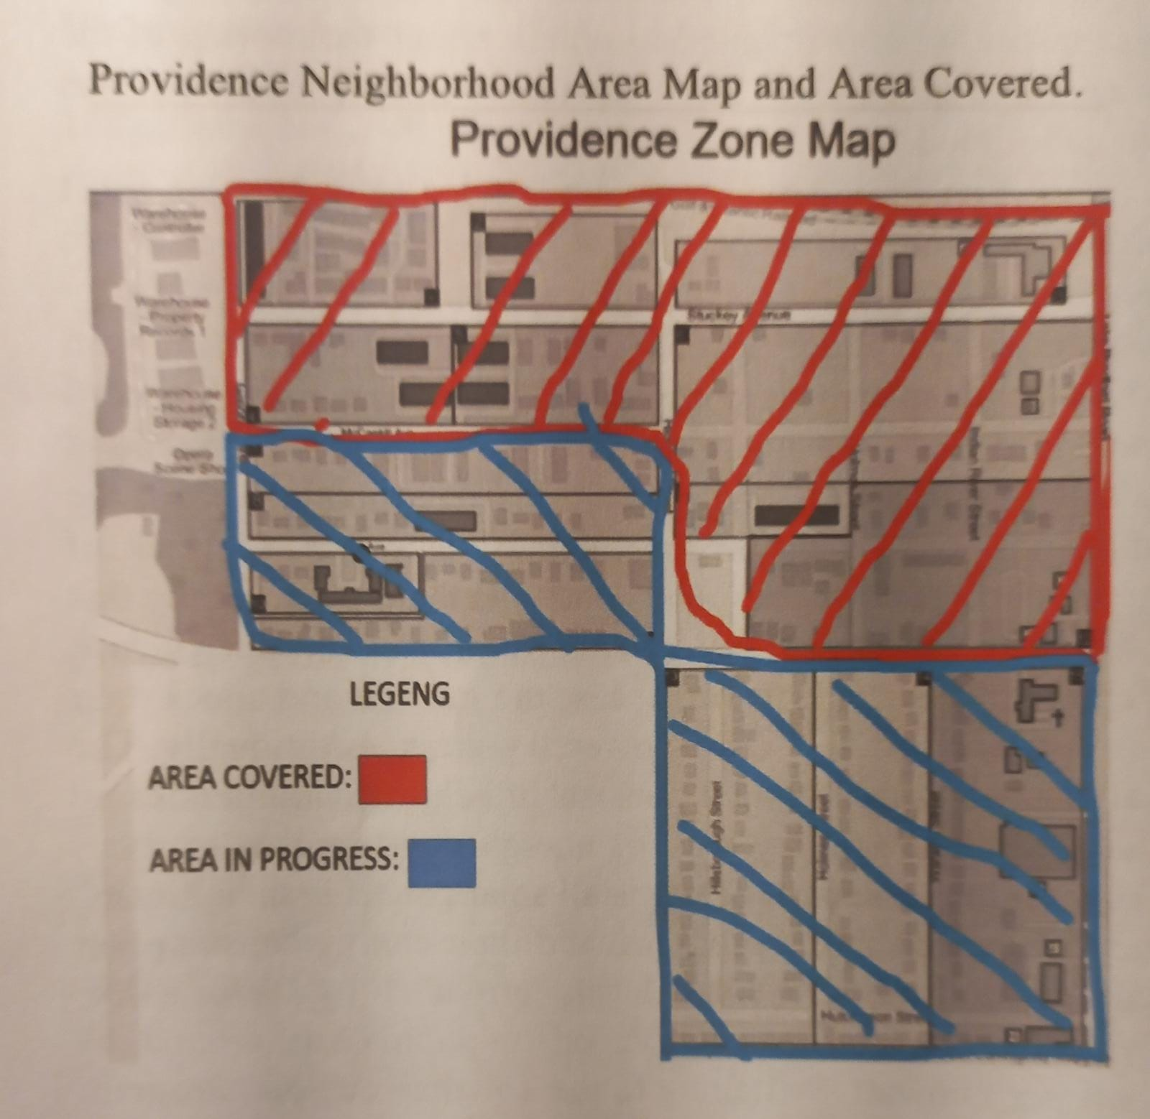



Review
Presenter: Angel Salges
Digital Wifi Canopy
  Solar powered charging station
Motivation
  Provide power to charge devices and wifi to people

Slide 6

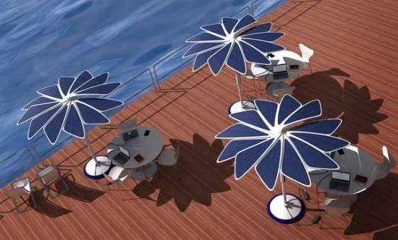




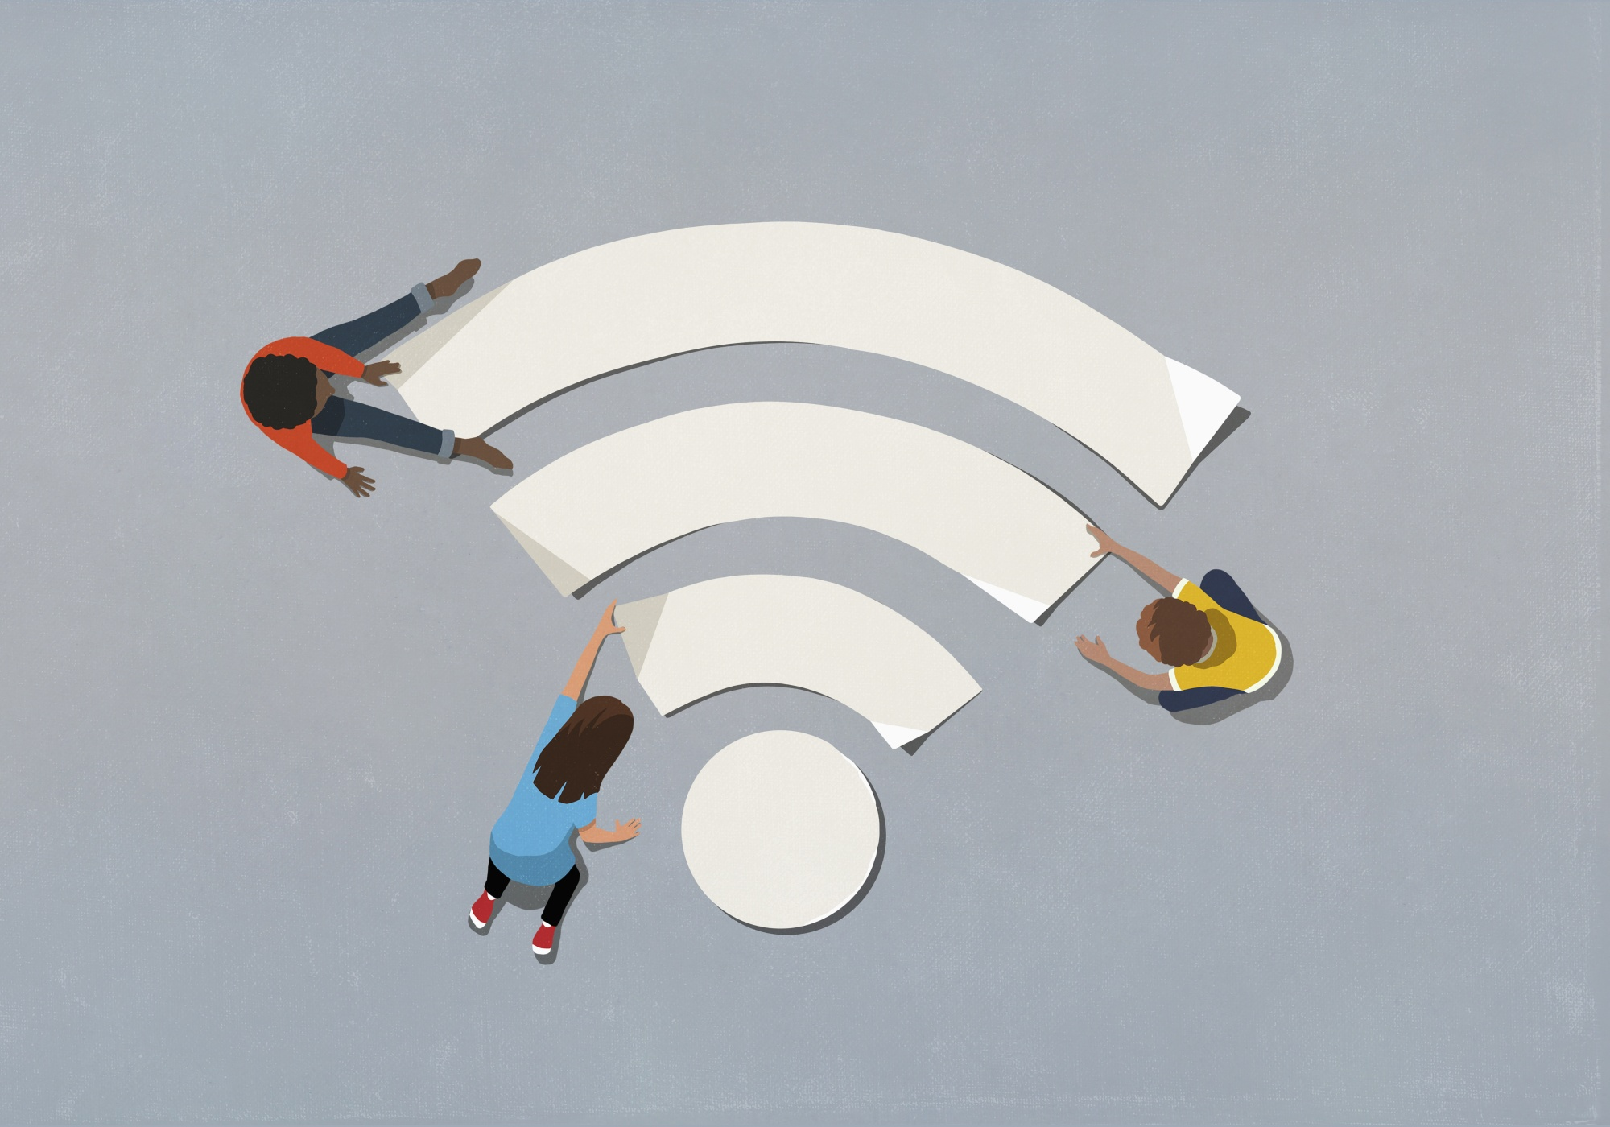
Review
Presenter: Angel Salges
Goals:
Use renewable energy
Aesthetically pleasing shelters
Convenience for users
Reduce the digital gap
Markets:
Primary: Transportation Companies,Park managements, Local Governments
Secondary:Restaurants, Individuals

Slide 7
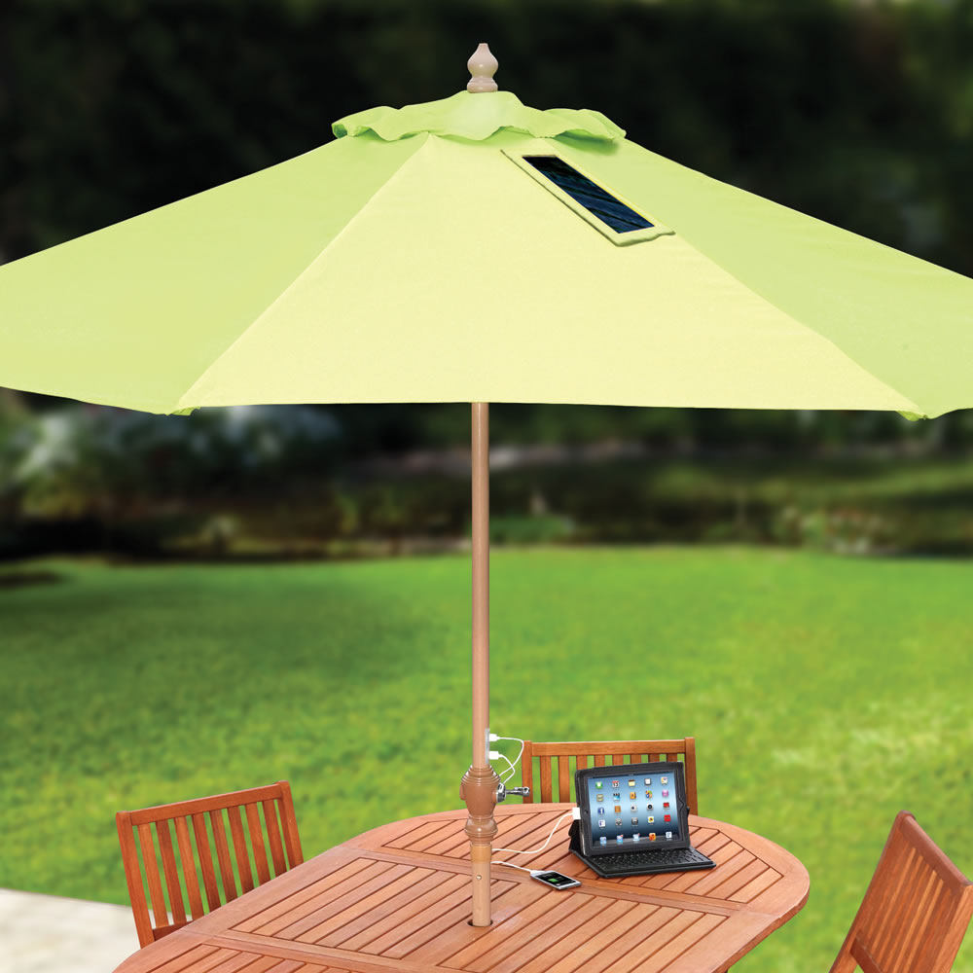
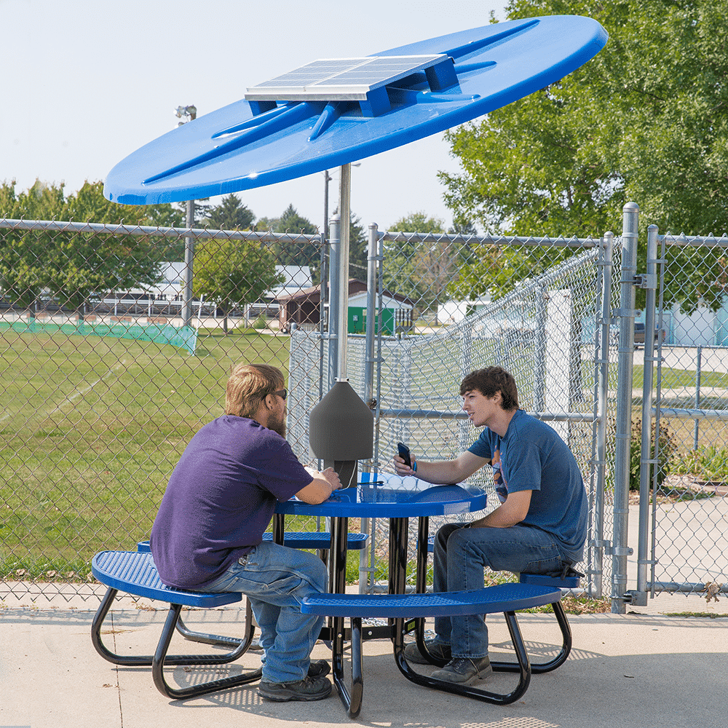
Review
Presenter: Angel Salges
Project Plan
  Provides power for charging through solar panels
  Withstand severe weather
Customer Needs
  Provides Power
  Provides Wifi and Charging Station
  Durable
  Movable
  Maintainable
  Reliable

Slide 8
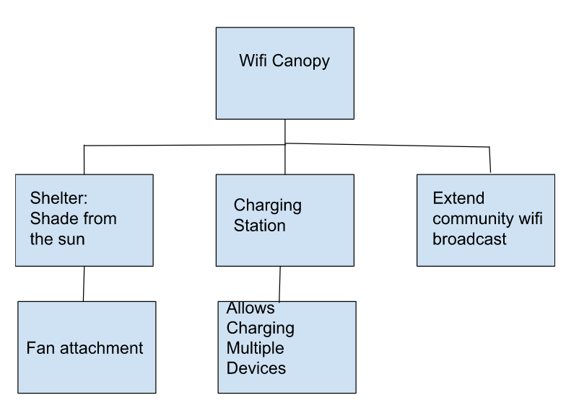
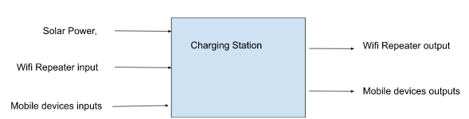
Review
Presenter: Angel Salges
Functional Decomposition

Slide 9
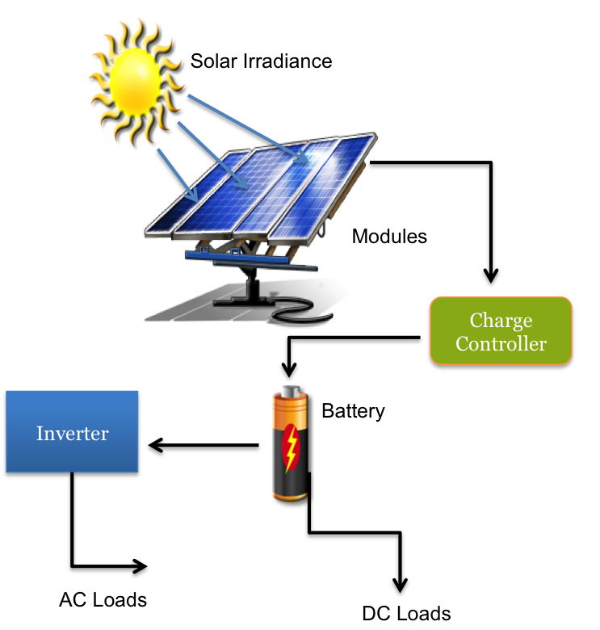

Target Summary
Presenter: Angel Salges
Uses solar energy to charge devices: Critical
This target is essential to the project. This is the primary purpose of building the device. Metric is binary as it only needs to use solar power per customer instructions.
Device will not break under a Hurricane:
This target is important for the safety and well-being of the people and the device. The metric was taken from the requirements of the Florida Building Code. The only limit to resistance would be the cost and not being able to be permanently fixed.

Slide 10

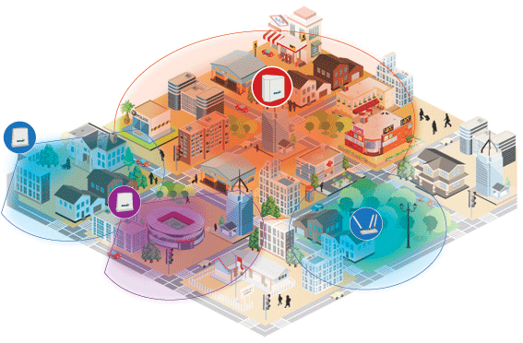
Target Summary
Presenter: Angel Salges
3. Will not be permanently attached:
This target aims to make the device movable to any place that is needed without it being destroyed. This is a goal but can be dismissed if incompatible with the previous target.
4. Provides WiFi to a Small Area:
This target is moderately important as it is a soft requirement and can be adjusted depending on price and power consumption. We will measure the broadcast of the network at different points more than 600m away from the device to see the reach.

Slide 11
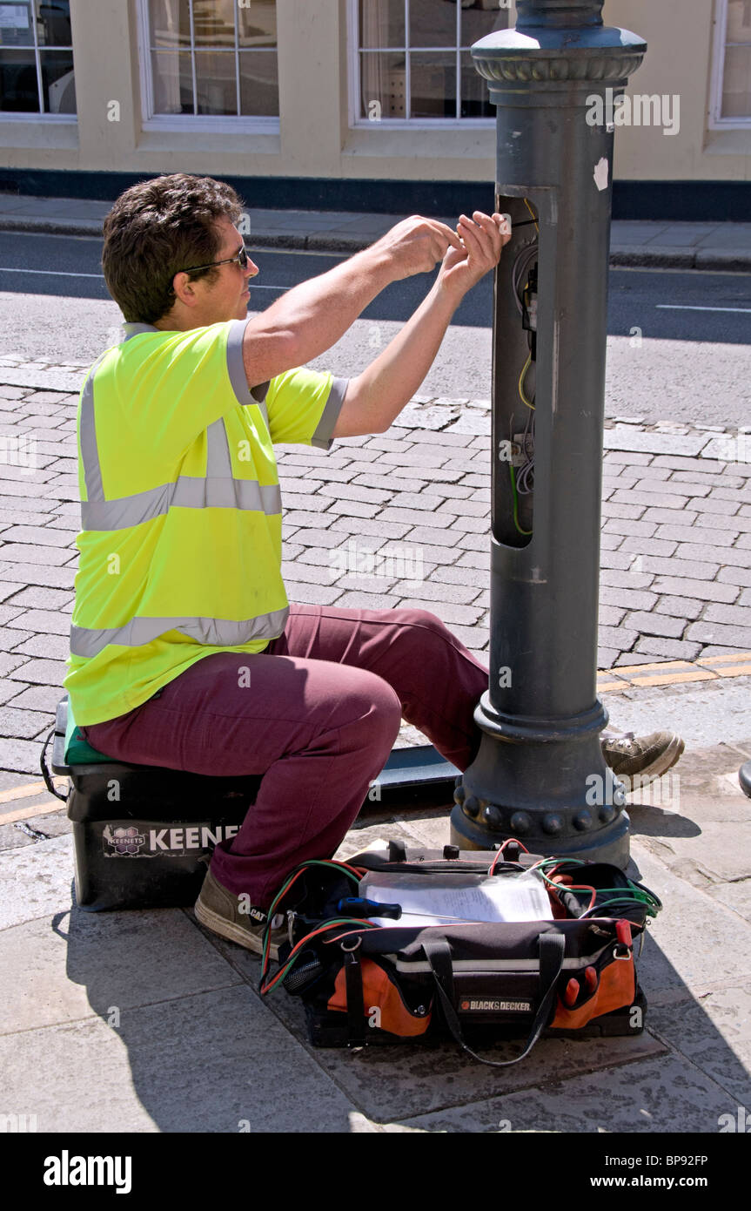

Target Summary
Presenter: Angel Salges
5. Components are accessible and replaceable:
This target aims to facilitate the interchange of pieces and the replacement of faulty equipment in the device. It also helps the long-term goal of modularity in the device. All pieces that need to be replaced at some point should be easily accessible to a crew without complete disassembly.
6. Will use a battery to store power: Critical
This target’s goal is to make the device usable even without constant sun at any given time. The battery should last at least 10 hours.
The battery will be timed from fully charged until total depletion and should be more than 10h.

Slide 12
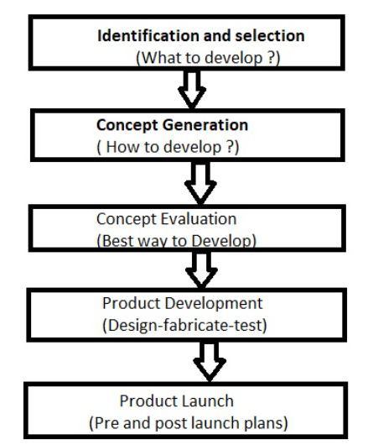
Concept Generation
Presenter: Victor Perry
During our team’s concept generation, we made a table to show all the different combinations we could use based on the required materials, size, and shape to implement our design.
Notes:
Victor- cross reference table based on our design requirements

Slide 13
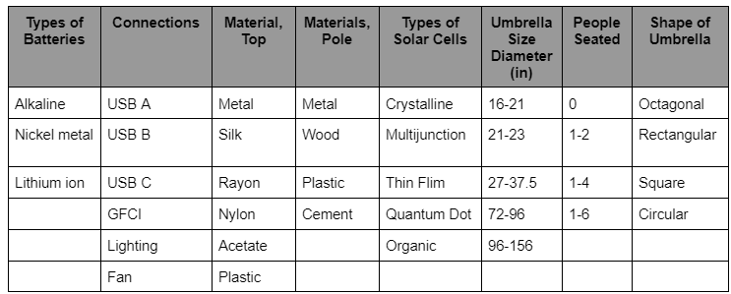
Concept Generation
Presenter: Victor Perry
“100” Concepts
Notes:
Vi

Slide 14
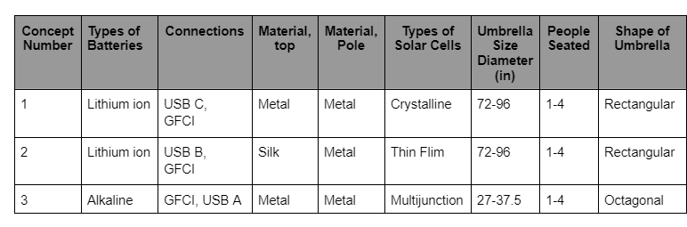

Concept Generation
Presenter: Victor Perry
High Fidelity Concepts:
Notes:
Victor- cross reference table based on our design requirements

Slide 15
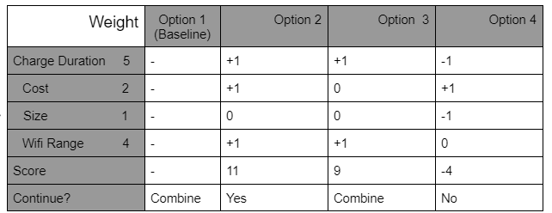
Concept Selection
Presenter: Victor Perry
Pugh Selection
This table weighs the design needs based on its priority and compares our three high fidelity concepts.
Notes:
Victor- cross reference table based on our design requirements

Slide 16
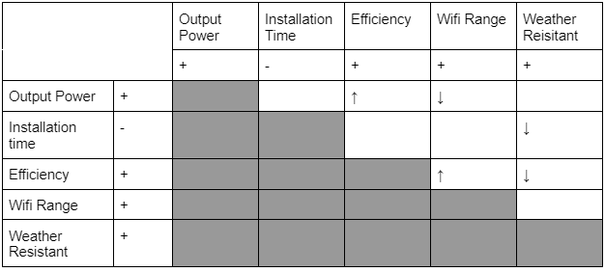
Concept Selection
Presenter: Victor Perry
Engineering Matrix
The chart compares the customer needs with the engineering requirements in Customer Matrix
Notes:
Victor- cross reference table based on our design requirements

Slide 17
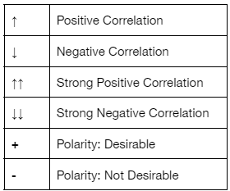
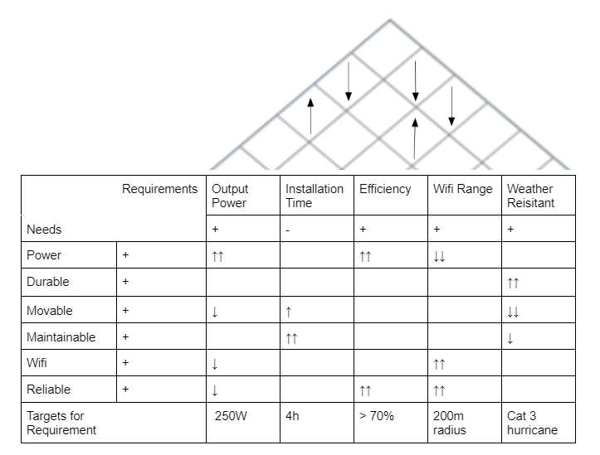
Concept Selection
Presenter: Victor Perry
House of Quality
This builds on the Customer Matrix which compares the designs’ needs and requirements.
The weather resistant category comes from the customer needs of durable and reliable. The category 3 hurricane requirement comes from the Florida Building Code.
In the bottom row of the House of Quality, the targets for requirements are shown.
Notes:
Victor- cross reference table based on our design requirements

Slide 18
Bill of Materials
Presenter: Alana Brandt
Item Ref # | Description | Part Number | Quantity | Unit | Unit Cost | Cost | Shipping | Total Cost | Vendor
1 | SolarLand Solar Panel 90W 12V | SLP090 | 2 | 1 | $203.37 | $406.74 | $32.12 | $438.86 | SolarLand
2 | Battery | ‎SMXE-2022101701 | 1 | 1 | $289.99 | $289.99 | $0.00 | $289.99 | Amazon
3 | WiFi Extender | WL-WN583AX1 | 1 | 1 | $39.99 | $39.99 | $0.00 | $39.99 | Amazon
4 | Volt converter | 090600AFA | 1 | 1 | $12.99 | $12.99 | $0.00 | $12.99 | Amazon
5 | Wires | B073GQWKV4 | 1 | 1 | $ 27.95 | $ 27.95 | $0.00 | $ 27.95 | Amazon
6 | Solar charge controller | B087BC9X4S | 1 | 1 | $39.60 | $39.60 | $0.00 | $39.60 | Amazon
7 | Ports A&C | ‎YM1288 | 1 | 1 | $ 18.99 | $ 18.99 | $0.00 | $ 18.99 | Amazon
8 | Ports A | YM1236 | 1 | 1 | $ 11.99 | $ 11.99 | $0.00 | $ 11.99 | Amazon
9 | Microcontroller | A000066 | 1 | 1 | $27.60 | $27.60 | $0.00 | $27.60 | Arduino

Slide 19
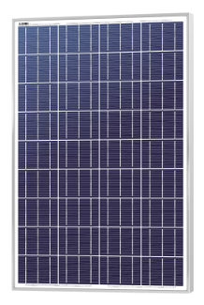
Bill of Materials
Presenter: Alana Brandt
Type: Polycrystalline Solar Panel
Length: 37.01 in.
Width: 26.57 in.
Nominal Voltage: 12V
Current: 7.5A
Power: 90W

Slide 20
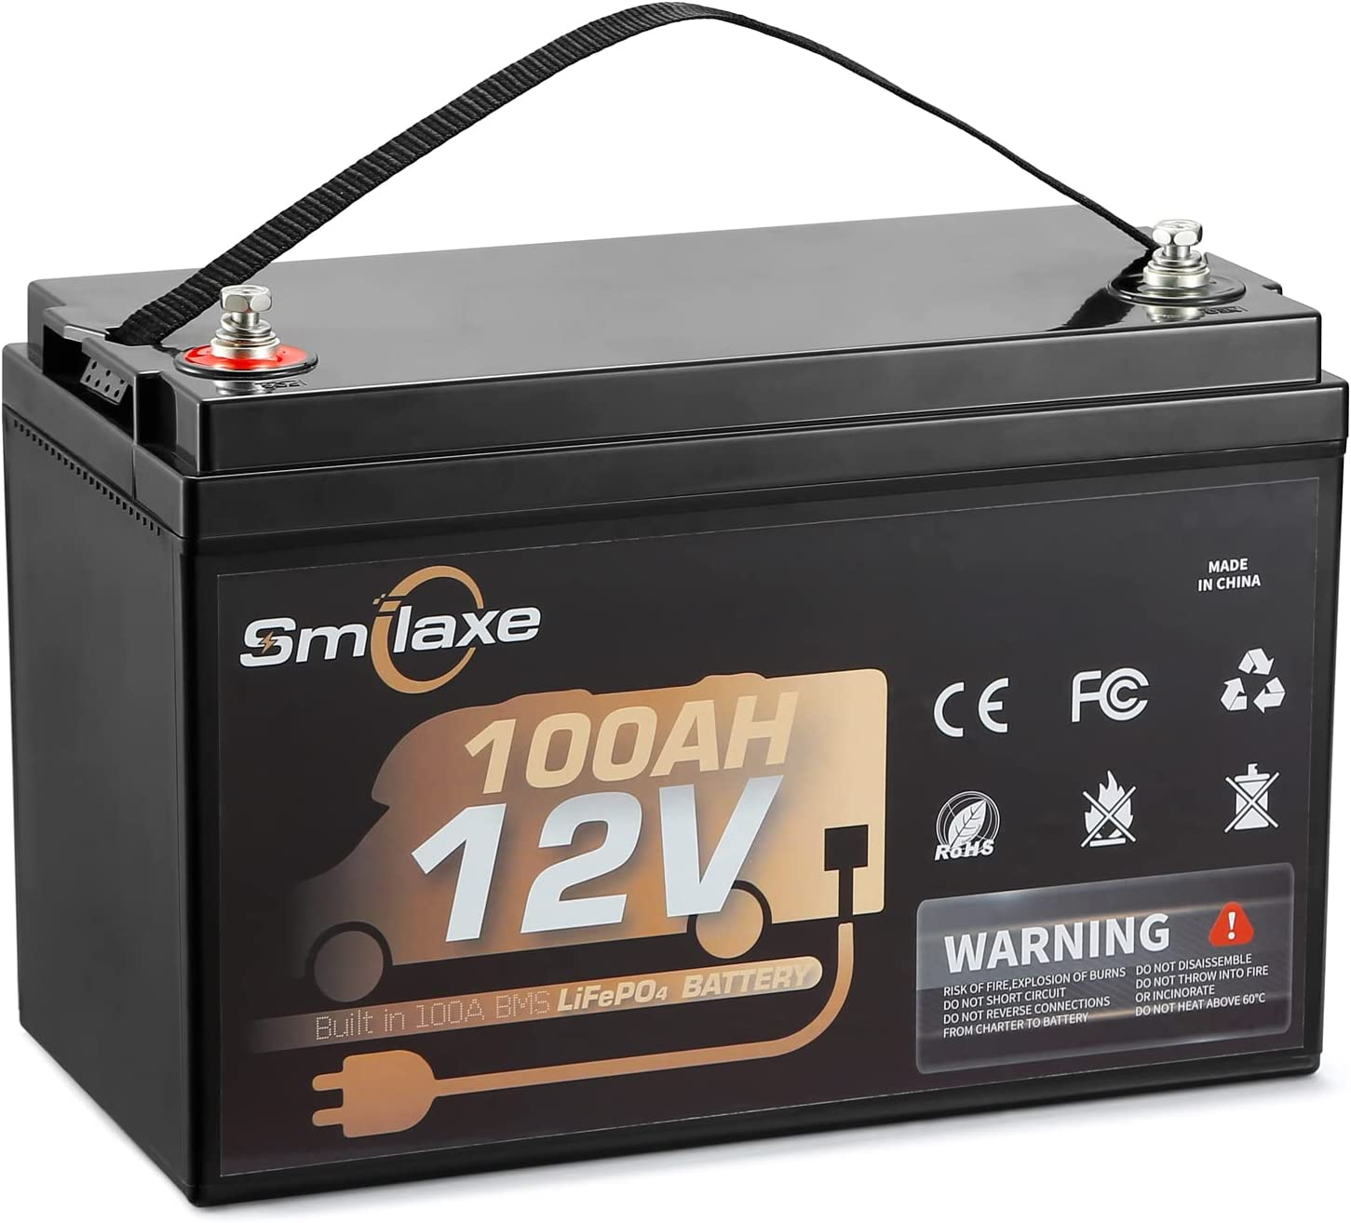
Bill of Materials
Presenter: Alana Brandt
Type: Lithium Iron Phosphate Battery
Voltage: 12V
Current: 100Ah
Power: 1200Wh

Slide 21
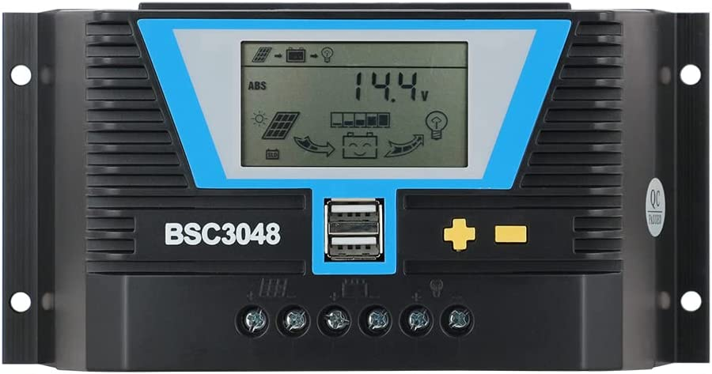
Bill of Materials
Presenter: Alana Brandt
Type: Solar Charge Converter
Voltage: 12V
Current Max : 30A
Power Output: 15W

Slide 22
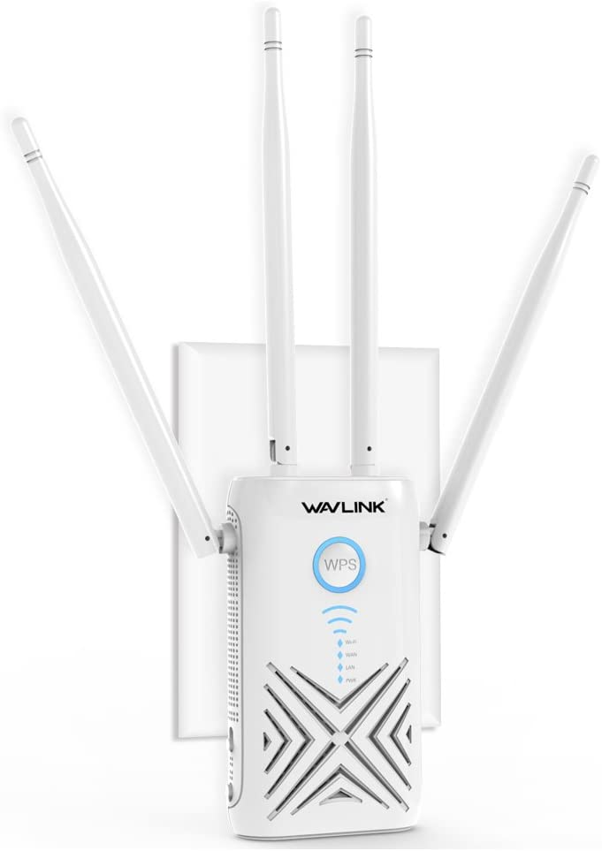
Bill of Materials
Presenter: Alana Brandt
Type: Wifi Extender
Voltage: 5V
Current: 2.5A
Power: 12.5W
Data Transfer Rate: 1200 Mbps

Slide 23
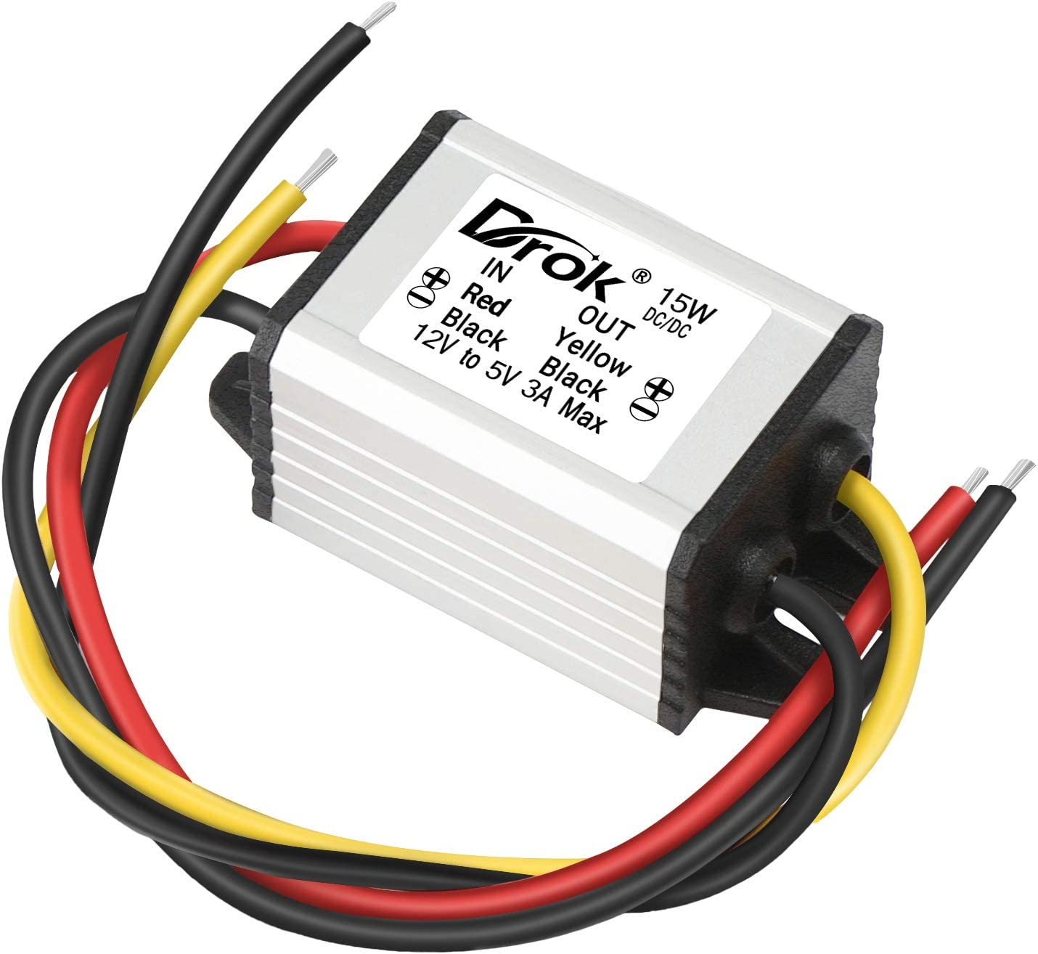
Bill of Materials
Presenter: Alana Brandt
Type: Volt Converter
Input Voltage: 12V
Output Voltage: 5V
Current Output: 3A
Power Output: 15W

Slide 24
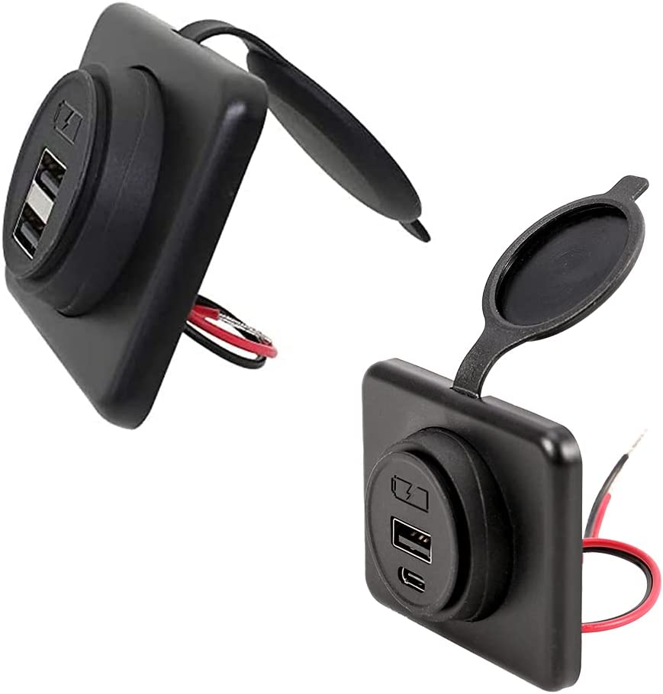
Bill of Materials
Presenter: Alana Brandt
Type: USB A & USB C Outlets
Voltage: 12V
Current: 2.1A
Power: 25.2W

Slide 25
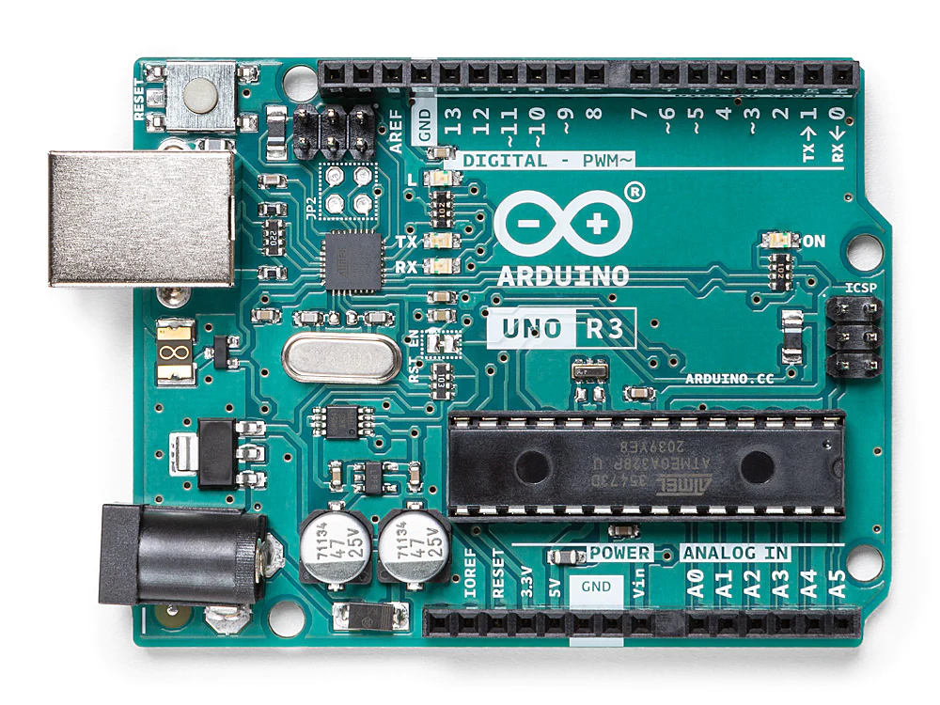
Bill of Materials
Presenter: Alana Brandt
Type: Microcontroller
Input Voltage: 7-12V
Pins:14

Slide 26
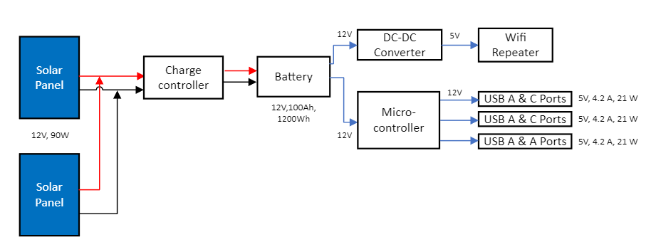
Initial detail design (Block Diagram)
Presenter: Hetanshu Patel

Slide 27
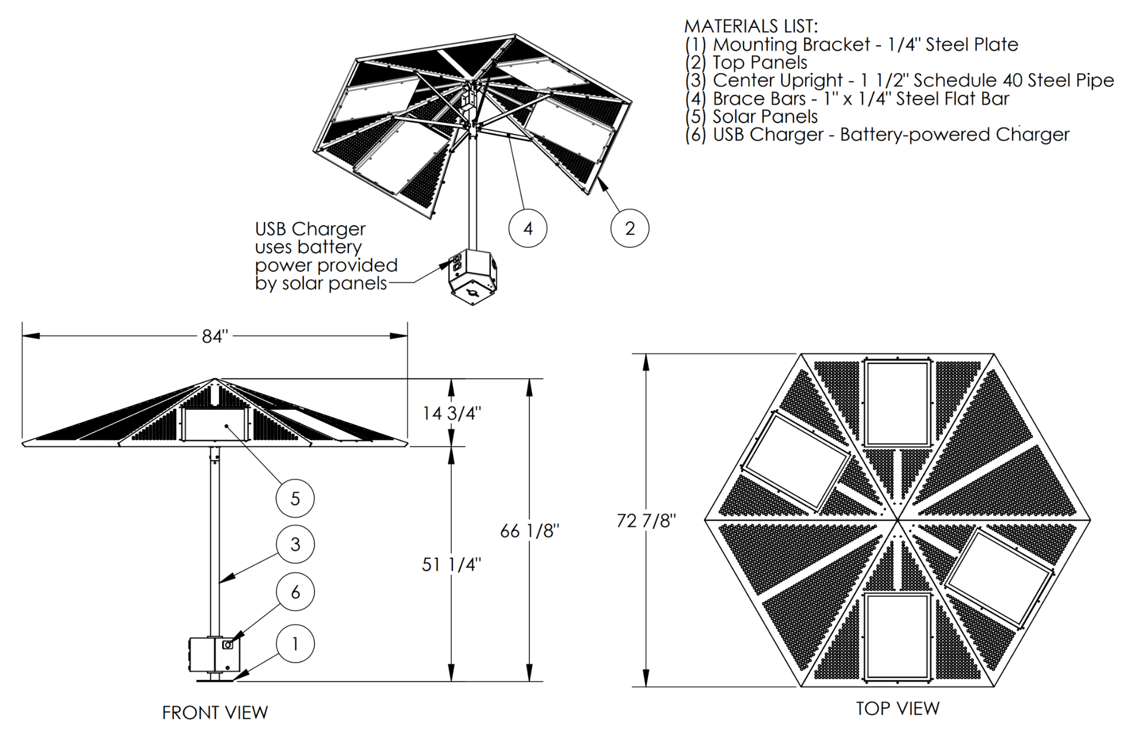
Initial Detail design
Presenter: Hetanshu Patel

Slide 28
Presentation Recap
Presenter: Angel Salges
Review
- What we previously presented
Targets
- Aim to provide power, use solar panels, batteries, be durable, not fixed, provide wifi and its maintainable
Bill of Materials
- List of materials and specifications of items we will be using
Concept Generation and Selection
- Elaborated designs and how we chose our current path.
Diagrams
- Detail how the circuit will look and the insides of the charge controller
Notes:
victor

Slide 29
References
Presenter: Angel Salges
“USB-Charging Solar Market Umbrella,” The Green Head - Finds Cool New Stuff! https://www.thegreenhead.com/2013/04/usb-charging-solar-market-umbrella.php (accessed Oct. 21, 2022).
“SiteScapes Inc. - Solar Panel Umbrellas,” www.sitescapesonline.com. https://www.sitescapesonline.com/solar-panel-umbrellas.asp (accessed Oct. 21, 2022).
“Solar Charge Station with Fiberglass Umbrella,” Kay Park & Recreation. https://kaypark.com/product/solar-charge-station-with-fiberglass-umbrella/ (accessed Oct. 21, 2022).
“Solar-Powered Umbrellas,” TrendHunter.com. https://www.trendhunter.com/trends/solaris-sun-shade (accessed Oct. 21, 2022).
Notes:
Not this slide will advance on default after 2 seconds. If you would like to change this then go to the transition tab and under timing change the advance slide settings.

Slide 30
Questions

Slide 31
Backup Sildes
Supporting Slides to the content above.

Slide 33
Standard Shapes
Summary Box
Text box 1
Outlined Text Box

Slide 34

Approved Logos

Slide 35
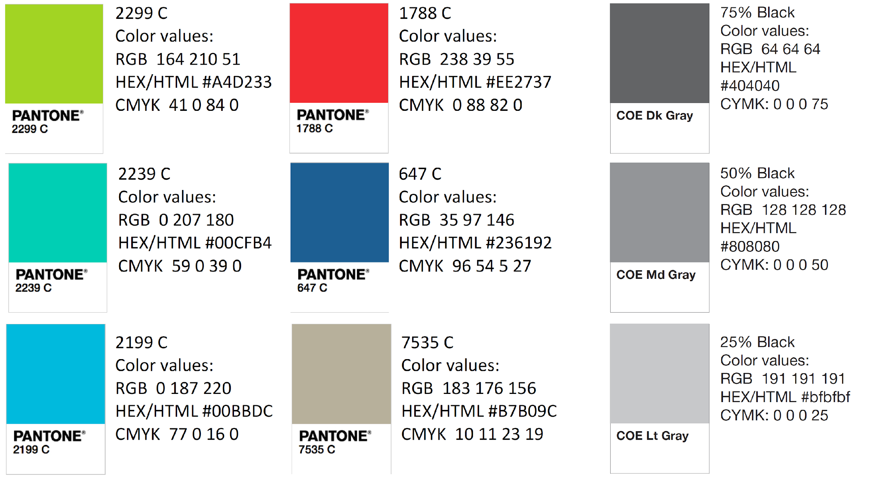
Color Palette

Slide 36
APA Tables
Category 1 | Category 2 | Category 3 | Category 4 | Category 5
Item 1
Item 2
Item 3
Item 4
 | Category 2 |  |  | Category 3
Category 1 | subcategory 1 | subcategory 2 |  | subcategory 1 | subcategory 2
Item 1
Item 2
Item 3
Item 4

