Slide 1

Senior Design Team 312:
Digital Wi-Fi Canopy
EEL- 4911C
February 17, 2023

Slide 2
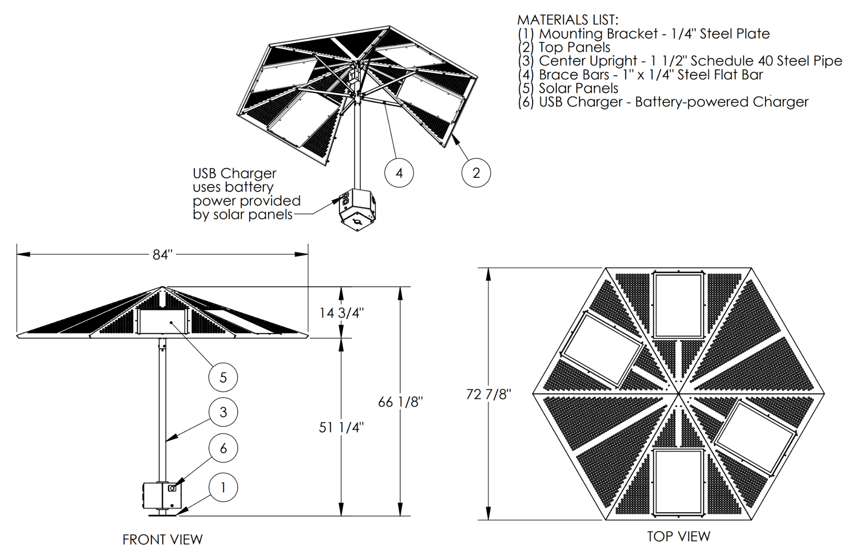
Objectives
Digital Wifi Canopy
  Solar Powered
  Provide USB Charging
  Provide Wifi

Slide 3
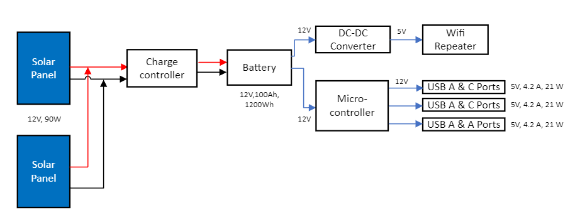
Block Diagram

Slide 4
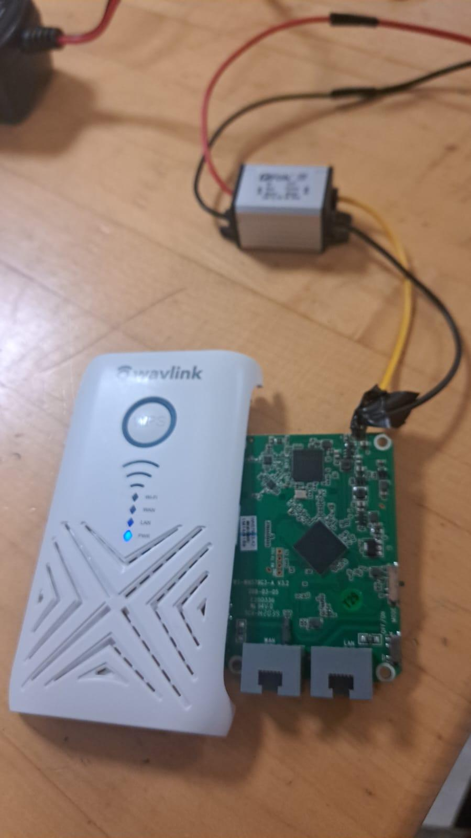
Prototype
Progress
Wifi repeater working and setup
USB ports tested
Waiting on other components

Slide 5
Protype
We are currently waiting for all of our materials to arrive to begin major testing, however, we have started with what we have which are the Wi-Fi Extender and USB ports. We removed the AC to DC converter from the Wi-Fi Extender inorder for the extender to work on DC power.

Slide 6
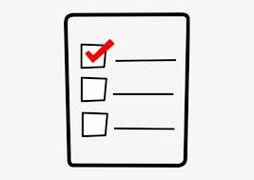
Time Table
Future work will include building, testing, and possible upgrades. We want to finish building and testing by the end of March. We can then consider upgrades once we have assembled our prototype.
Building will involve soldering the components such as wiring the solar panels to the charge controller and then to the battery.
Testing will include Wi-Fi functionality and ports charging capability. In addition, testing will be performed on the battery charge duration and output power of the solar panels.
Possible upgrades to the canopy could be a independent conection to cellular network, lights, and a heater.

Slide 7
References
Presenter: Angel Salges
“USB-Charging Solar Market Umbrella,” The Green Head - Finds Cool New Stuff! https://www.thegreenhead.com/2013/04/usb-charging-solar-market-umbrella.php (accessed Oct. 21, 2022).
“SiteScapes Inc. - Solar Panel Umbrellas,” www.sitescapesonline.com. https://www.sitescapesonline.com/solar-panel-umbrellas.asp (accessed Oct. 21, 2022).
“Solar Charge Station with Fiberglass Umbrella,” Kay Park & Recreation. https://kaypark.com/product/solar-charge-station-with-fiberglass-umbrella/ (accessed Oct. 21, 2022).
“Solar-Powered Umbrellas,” TrendHunter.com. https://www.trendhunter.com/trends/solaris-sun-shade (accessed Oct. 21, 2022).
Notes:
Not this slide will advance on default after 2 seconds. If you would like to change this then go to the transition tab and under timing change the advance slide settings.

Slide 8
Questions?

