Slide 1

Senior Design Team 312:
Digital Wi-Fi Canopy
EEL- 4911C
March 24, 2023

Slide 2
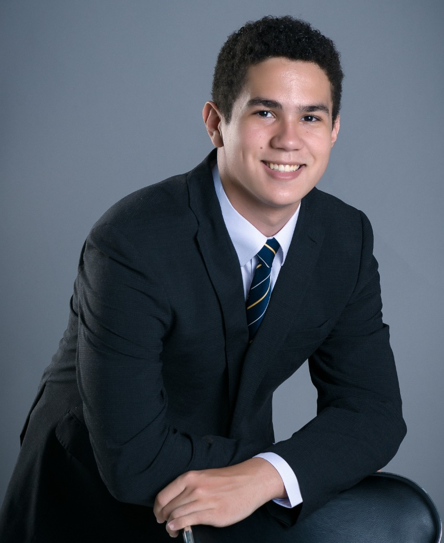
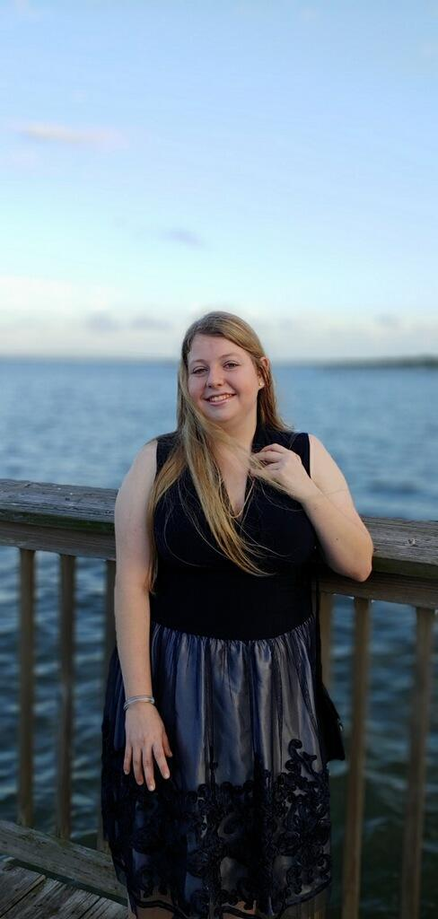

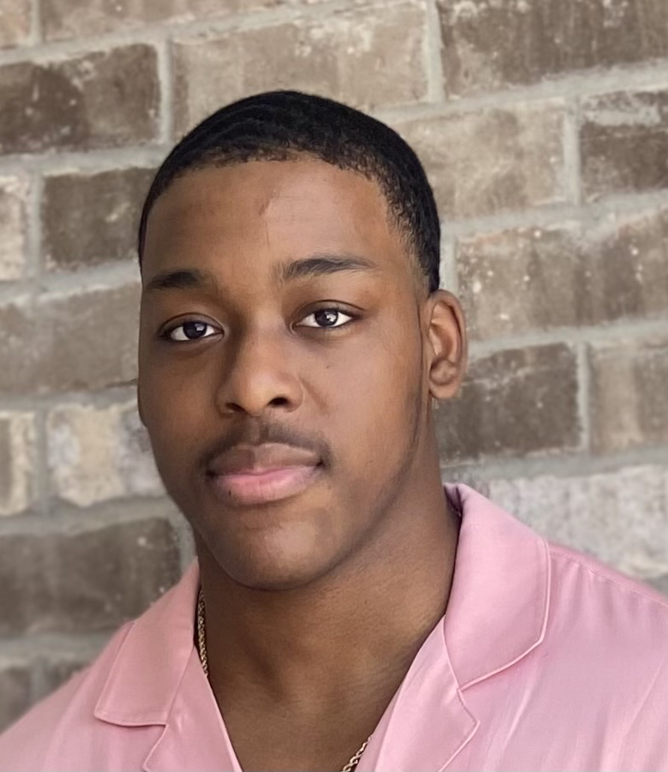
Team Introductions
Angel Salges
Team Leader
Alana Brandt
Lead Electrical Engineer
Hetanshu Patel
Software & Hardware Integration
Victor Perry
Test & Development
Engineer

Slide 3

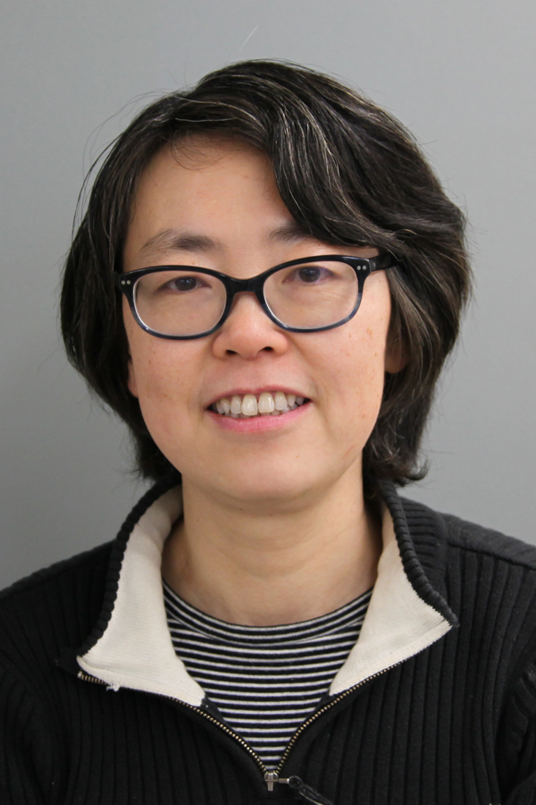

Sponsors
Advisor
Dr. Hui Li

Slide 4

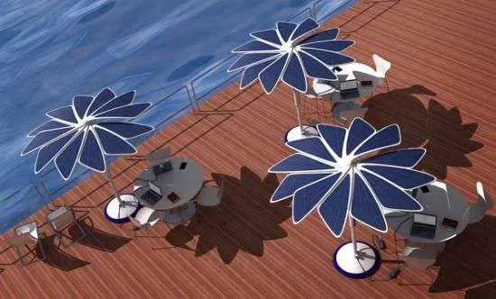

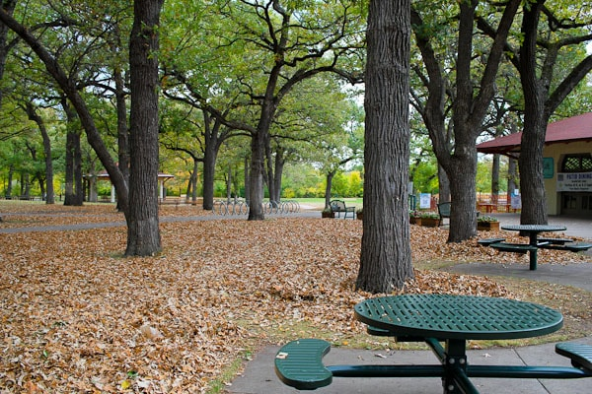
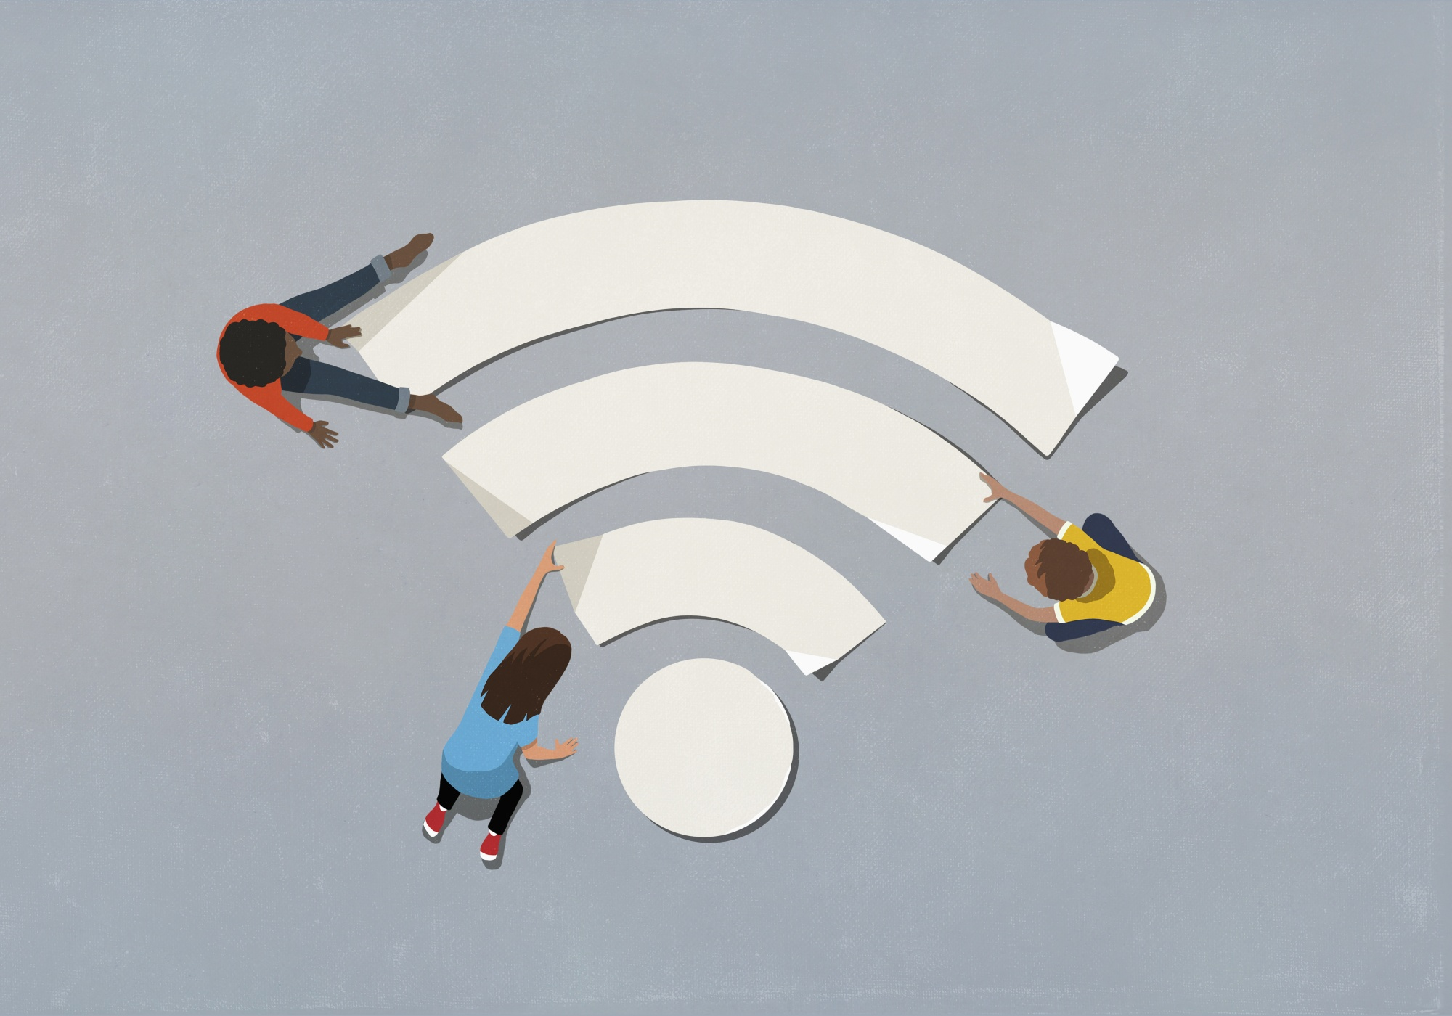
Project Scope
Goals:
Use renewable energy
Aesthetically pleasing shelters
Convenience for users
Reduce the digital gap
Develop shelters such as umbrella to be placed in public parks and bus stops which has the capability of charging electronic devices, provide shade, Wifi coverage using renewable energy as a source.

Slide 5
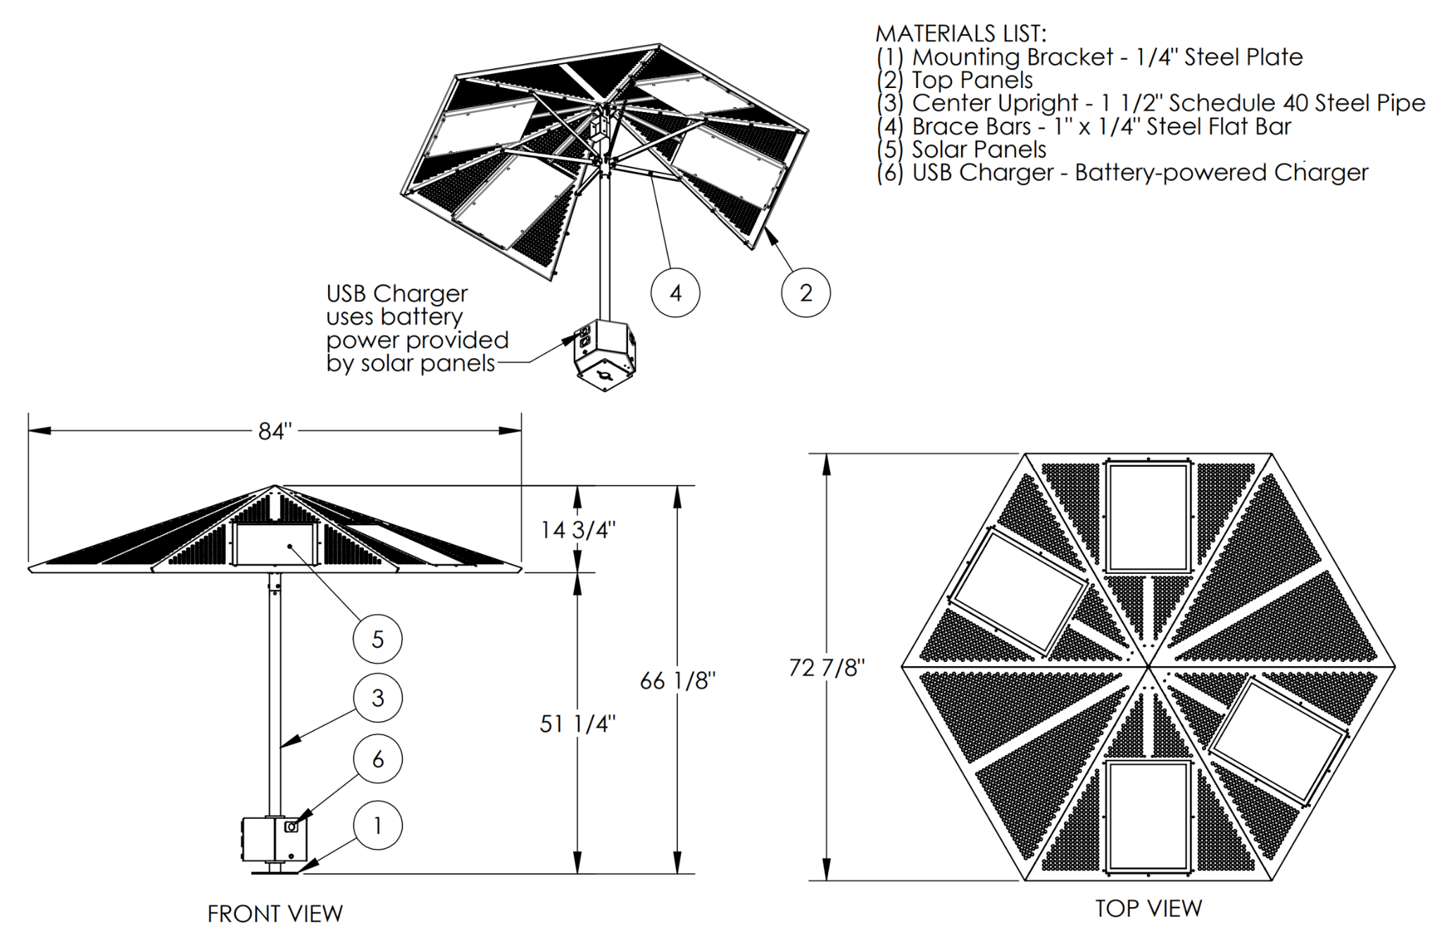
Design Concept
Digital Wifi Canopy
  Solar Powered
  Provide USB Charging
  Provide Wifi

Slide 6
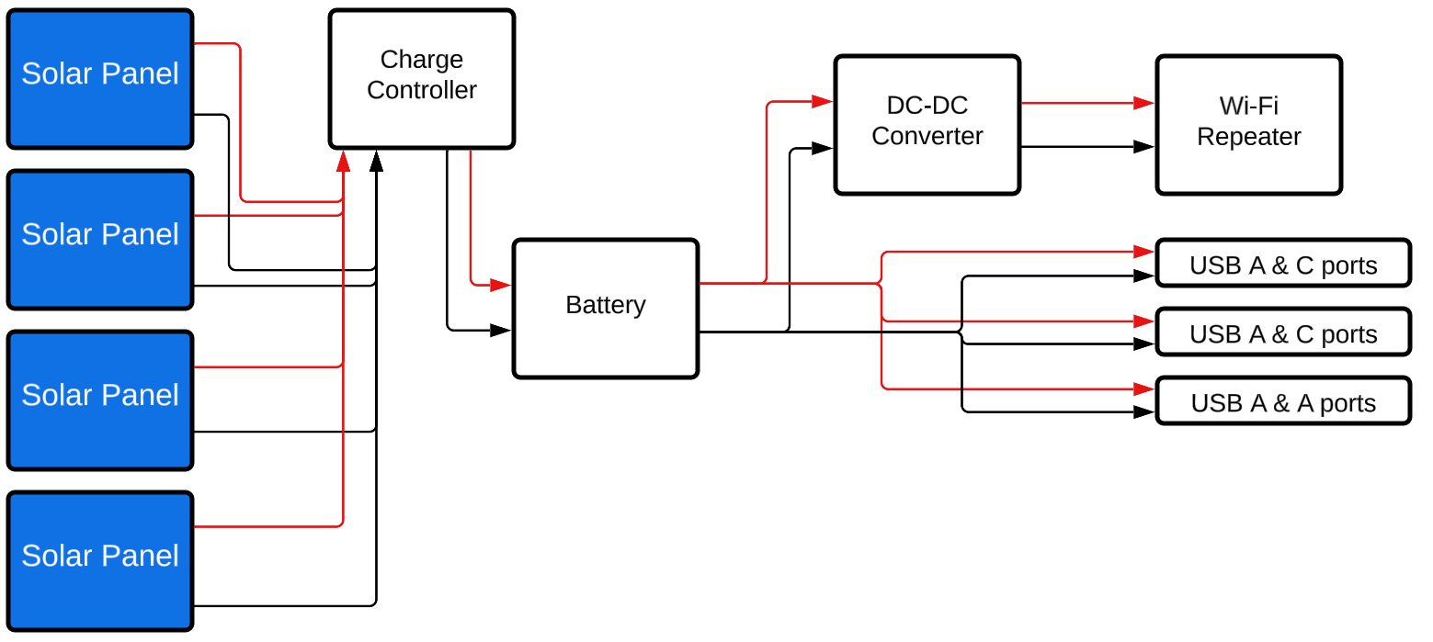
Block Diagram

Slide 7
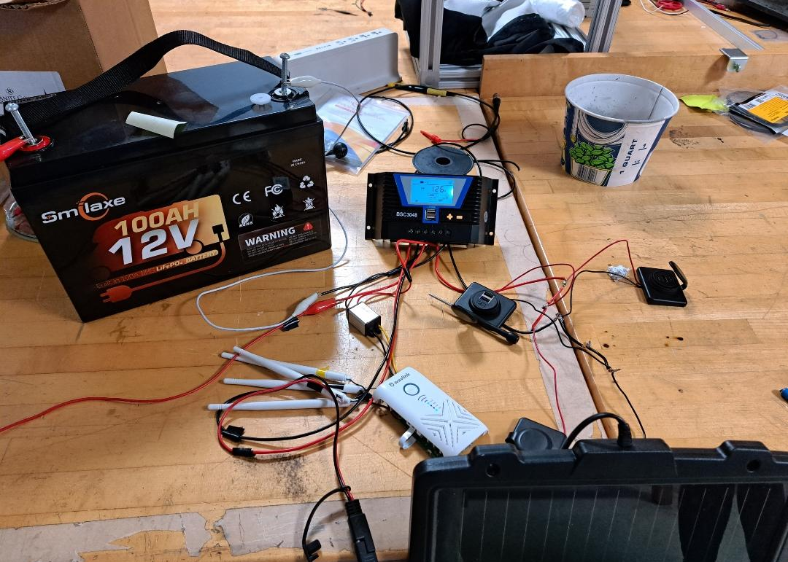
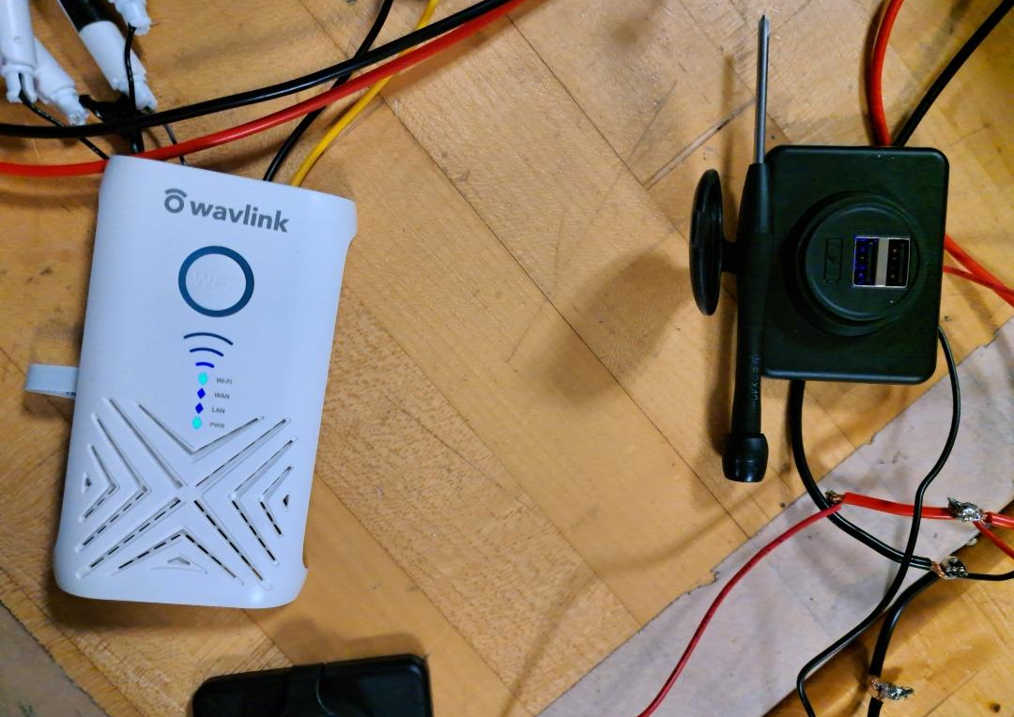
Circuit Schematics

Slide 8
Implementation of each module
We have successfully:
Tested the repeater reach and network
Tested and assembled the charging ports
Used the charge controller and battery to power the devices simultaneously
Charged the battery with the solar panel
Assembled and ran a first test on the whole project

Slide 9
Progress and Results
We have successfully built and solder parts and components together. All the components have been individually test and verified for proper functionality. Furthermore, we have assembled the final circuit and are in the process for collecting data on average time solar panels need to fully charge the battery and total hours of runtime on the battery alone.
Notes:
Not this slide will advance on default after 2 seconds. If you would like to change this then go to the transition tab and under timing change the advance slide settings.

Slide 10
Implementation Issues/ Problems Encountered
Safe location to test our circuit
One of the solar panels not working efficiently
Problems with the orders
  Battery and Panels

Slide 11
Current Status with respect to final Deliverables
We are currently on target with respect to the final deliverables. After performing several test runs, doing some optimizations if needed and organizing the overall layout, our project will be ready for final presentation.

Slide 12
Questions?

