Slide 1

Senior Design Team 312:
Digital Wi-Fi Canopy
EEL- 4914C
April 6, 2023

Slide 2




Team Introductions
Angel Salges
Team Leader
Alana Brandt
Lead Electrical Engineer
Hetanshu Patel
Software & Hardware Integration
Victor Perry
Test & Development
Engineer

Slide 3



Sponsors
Advisor
Dr. Hui Li

Slide 4
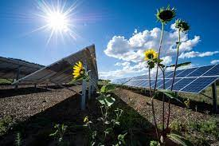




Project Scope
Goals:
Use renewable energy
Aesthetically pleasing shelters
Convenience for users
Reduce the digital gap
Develop shelters such as umbrella to be placed in public parks and bus stops. The umbrellas need to be capability of charging electronic devices, providing shade, and Wifi coverage using solar energy.

Slide 5
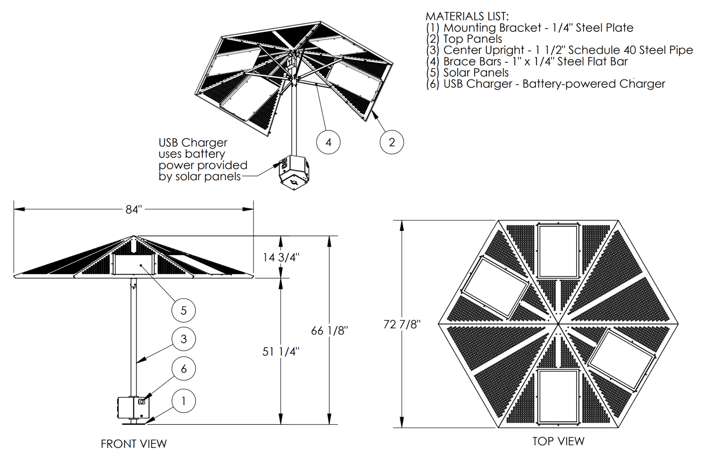
Design Concept
Digital Wifi Canopy
  Solar Powered
  Provide USB Charging
  Provide Wifi

Slide 6
Bill of Materials
Item Ref # | Description | Part Number | Quantity | Unit | Unit Cost | Cost | Shipping | Total Cost | Vendor
1 | ACOPOWER 60 Watt 60W Solar Panel 12 Volt | HY060-12P | 4 | 1 | $85.99 | $343.96 | $0.00 | $343.96 | Amazon
2 | Battery | ‎SMXE-2022101701 | 1 | 1 | $289.99 | $289.99 | $0.00 | $289.99 | Amazon
3 | WiFi Extender | WL-WN583AX1 | 1 | 1 | $39.99 | $39.99 | $0.00 | $39.99 | Amazon
4 | Volt converter | 090600AFA | 1 | 1 | $12.99 | $12.99 | $0.00 | $12.99 | Amazon
5 | Wires | B073GQWKV4 | 1 | 1 | $ 27.95 | $ 27.95 | $0.00 | $ 27.95 | Amazon
6 | Solar charge controller | B087BC9X4S | 1 | 1 | $39.60 | $39.60 | $0.00 | $39.60 | Amazon
7 | Ports A&C | ‎YM1288 | 1 | 1 | $ 18.99 | $ 18.99 | $0.00 | $ 18.99 | Amazon
8 | Ports A | YM1236 | 1 | 1 | $ 11.99 | $ 11.99 | $0.00 | $ 11.99 | Amazon

Slide 7
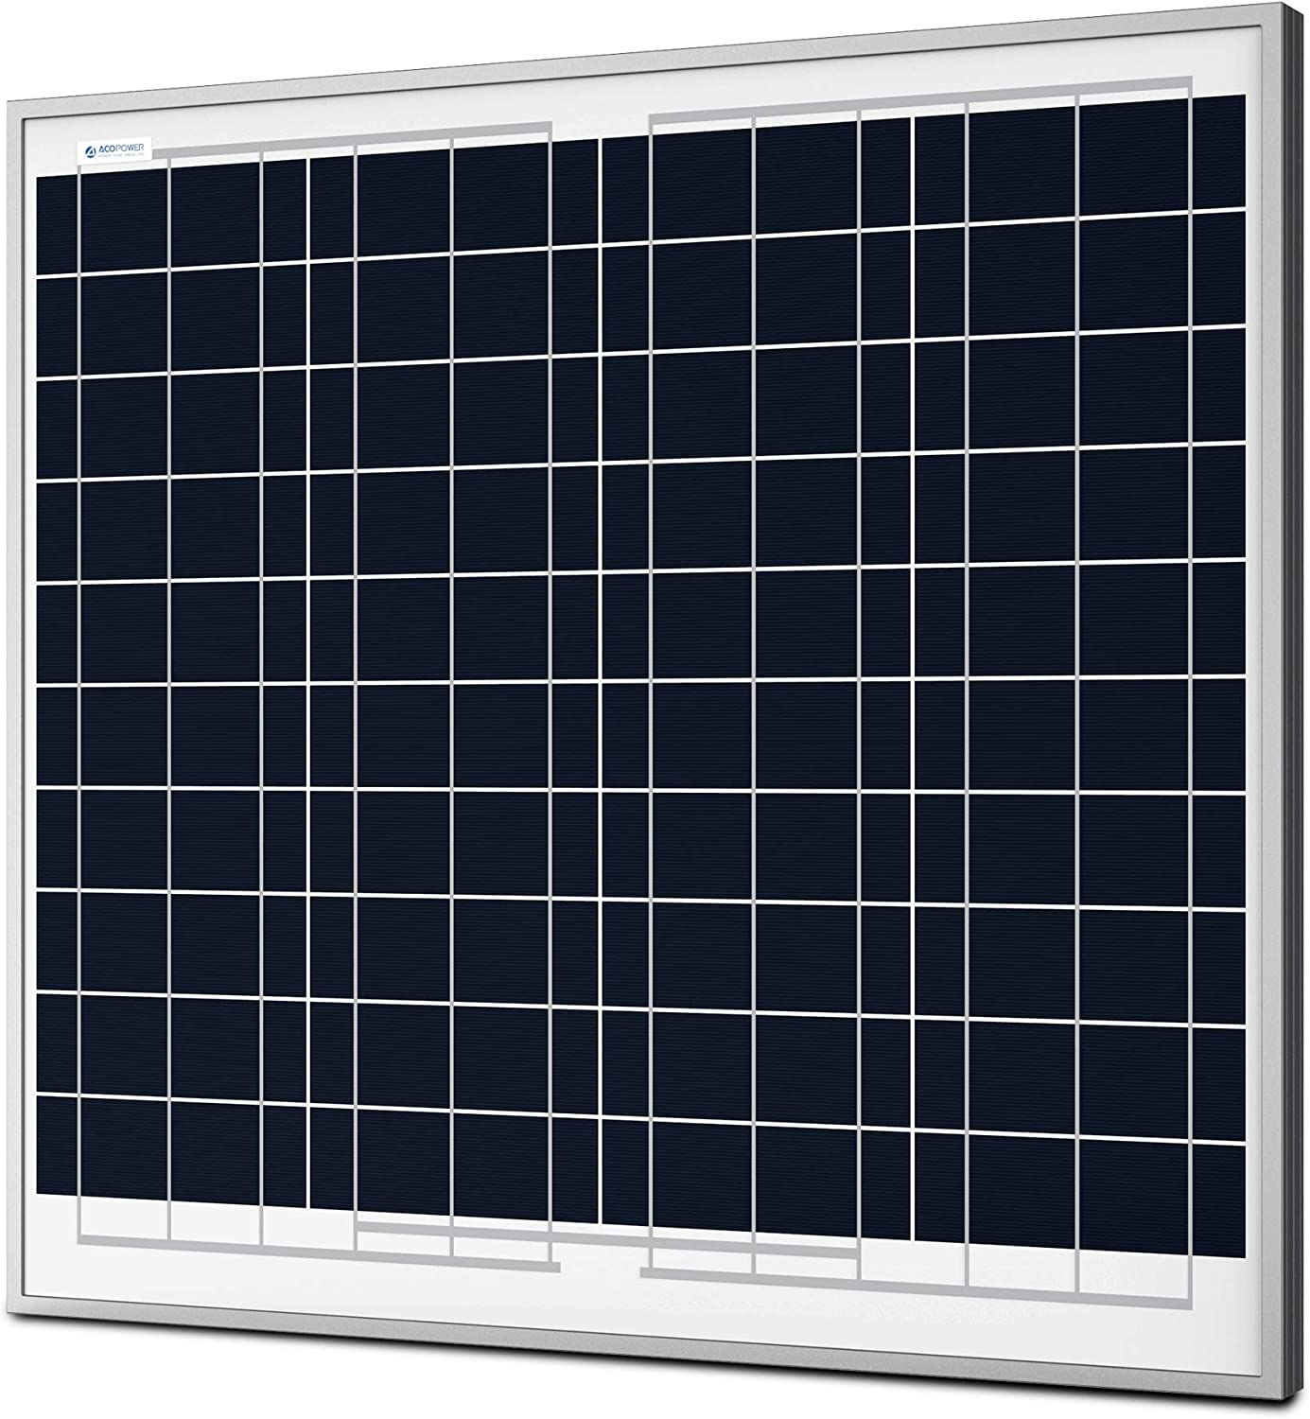
Bill of Materials
Type: Polycrystalline Solar Panel
Length: 26.38 in.
Height: 24.4 in.
Nominal Voltage: 12V
Current: 3.6A
Peak Power: 60W

Slide 8
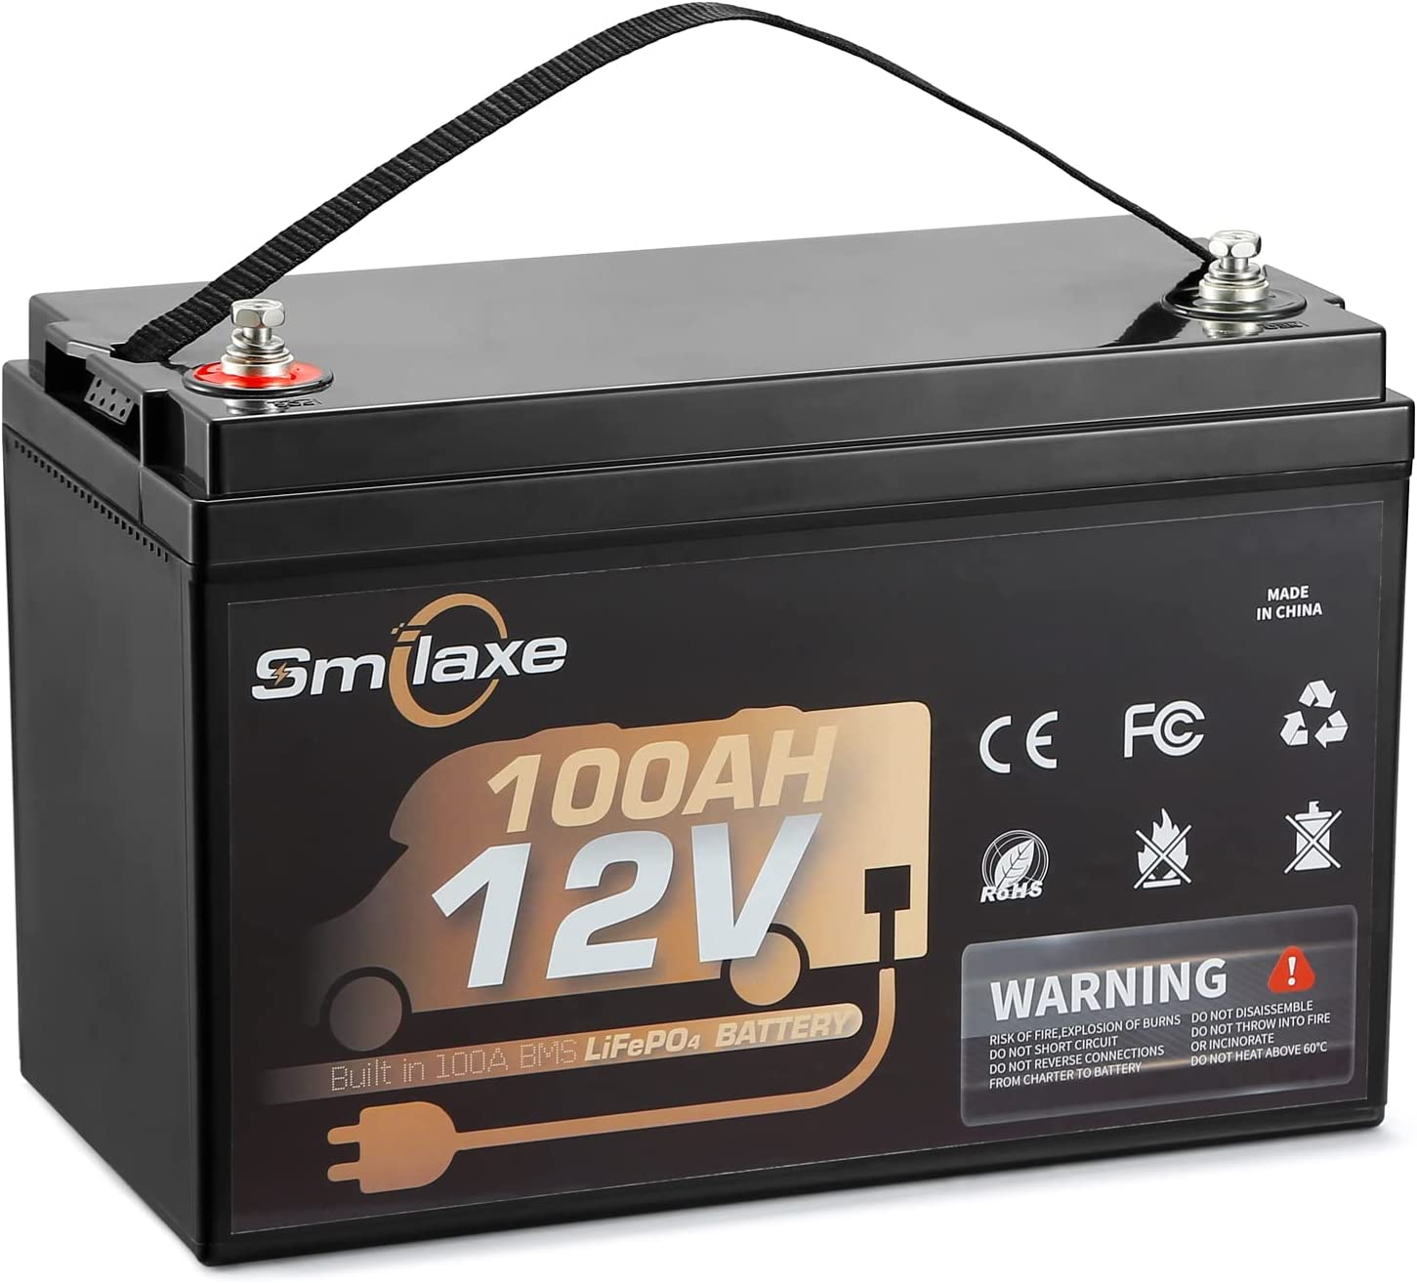
Bill of Materials
Type: Lithium Iron Phosphate Battery
Voltage: 12V
Current: 100Ah
Power: 1200Wh

Slide 9
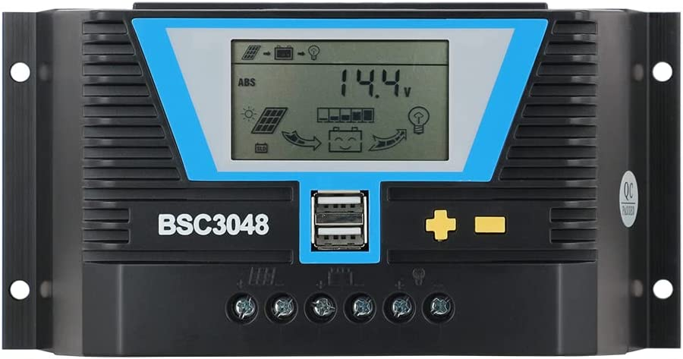
Bill of Materials
Type: Solar Charge Converter
Voltage: 12V
Current Max : 30A
Power Output: 240W
Notes:
Only a 20A charge controller was necessary the 30A one was cheaper.

Slide 10
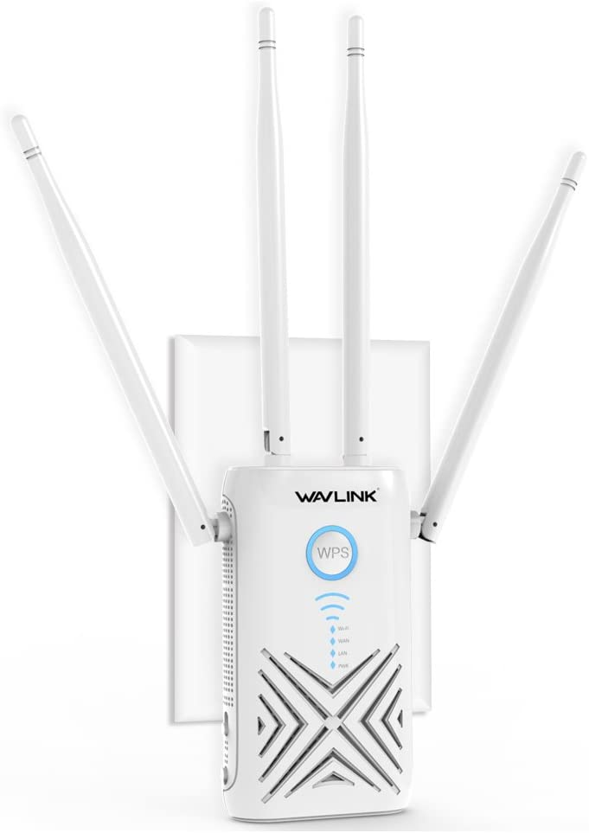
Bill of Materials
Type: Wifi Extender
Voltage: 5V
Current: 2.5A
Power: 12.5W
Data Transfer Rate: 1200 Mbps

Slide 11
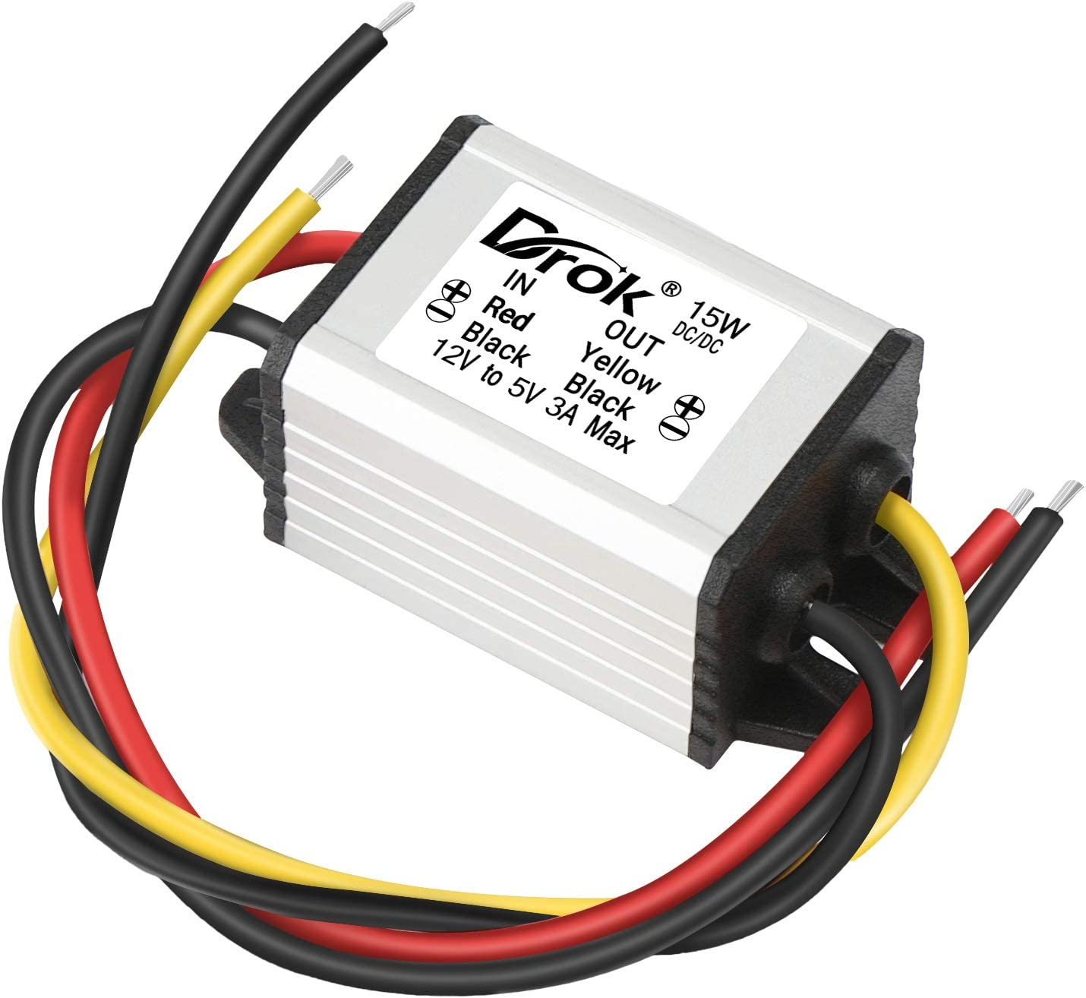
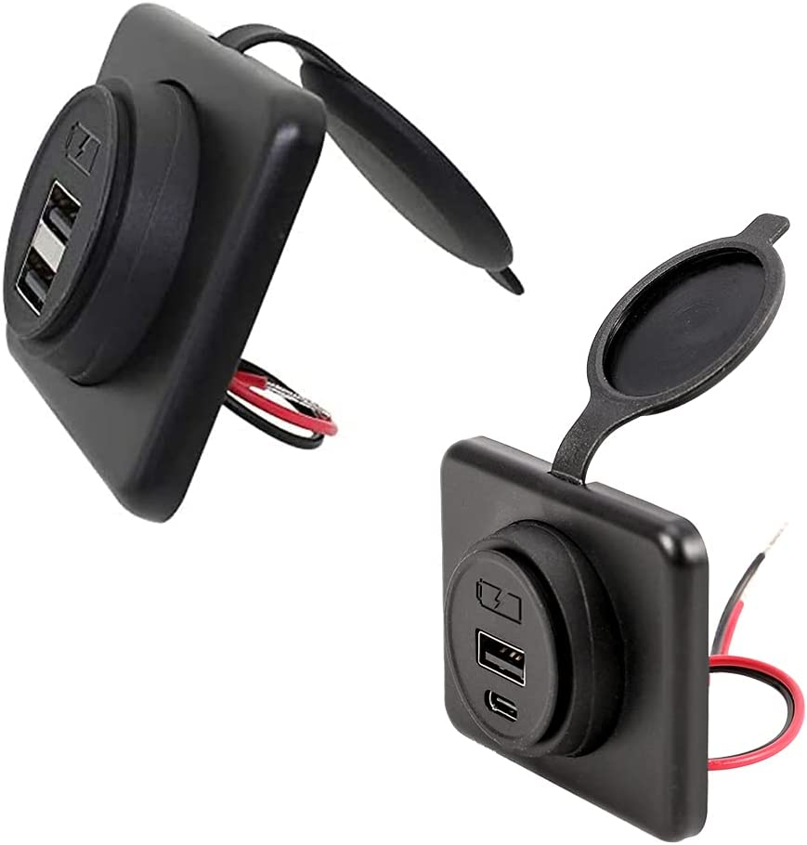
Bill of Materials
Type: Volt Converter
Input Voltage: 12V
Output Voltage: 5V
Current Output: 3A
Power Output: 15W
Type: USB A & USB C Outlets
Input Voltage: 12V
Input Current: 2A
Output Voltage: 5V
Output Current per USB Port: 2.1A
Output Power: 21W

Slide 12
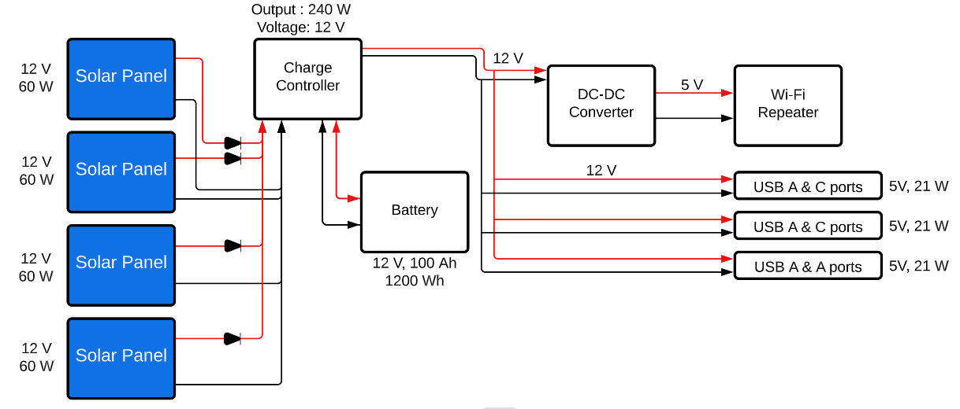
Block Diagram

Slide 13
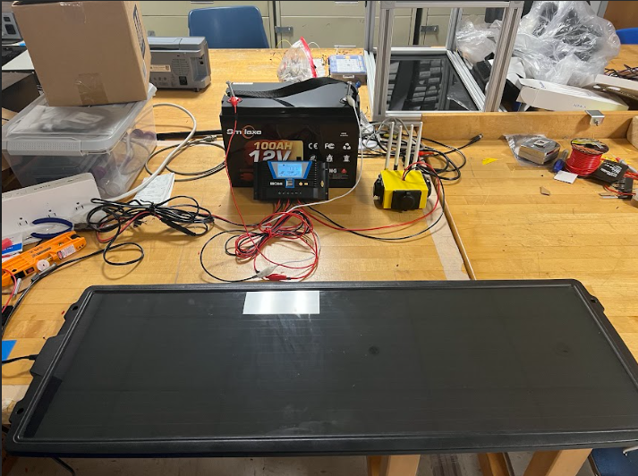
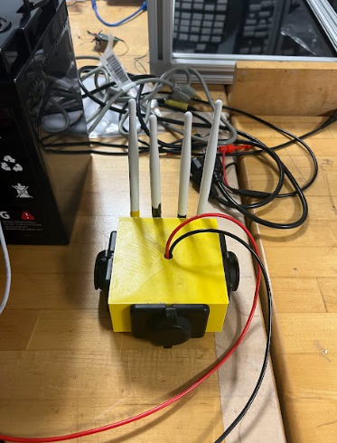
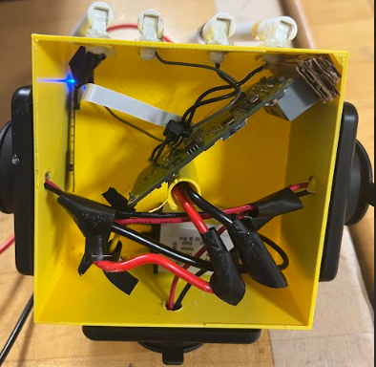
Circuit Schematics

Slide 14
Implementation of each module
We have successfully:
Tested the repeater reach and network
Tested and assembled the charging ports
Used the charge controller and battery to power the devices simultaneously
Charged the battery with the solar panel
Assembled and ran a first test on the whole project

Slide 15
Progress and Results
We have successfully built and soldered the circuit together. All the components have been individually test and verified for proper functionality. Furthermore, we have collected the necessary data on the solar panels. Based on the calculations for the desired solar panels the battery will run for 10 hours fully charged. The circuit is done testing and is ready to be implemented into the umbrella structure.

Slide 16
Implementation Issues/ Problems Encountered
Good location to test our circuit
One of the solar panels not working correctly
Problems with the orders
  Battery and Panels

Slide 17
Questions?

