Slide 1


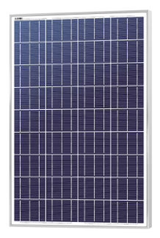
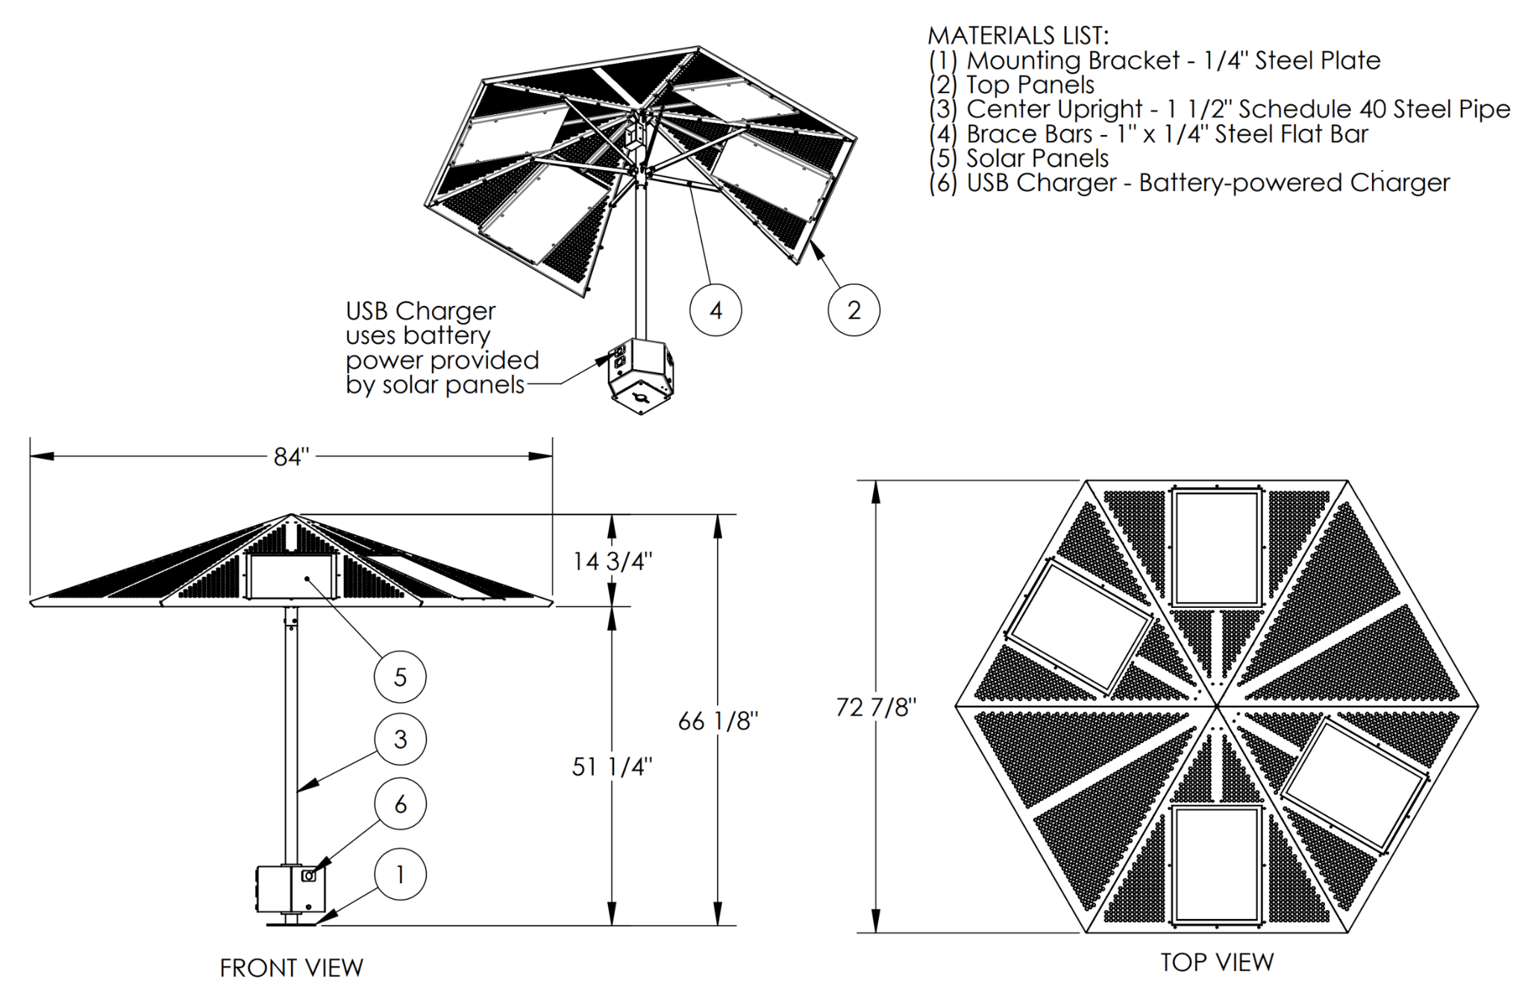
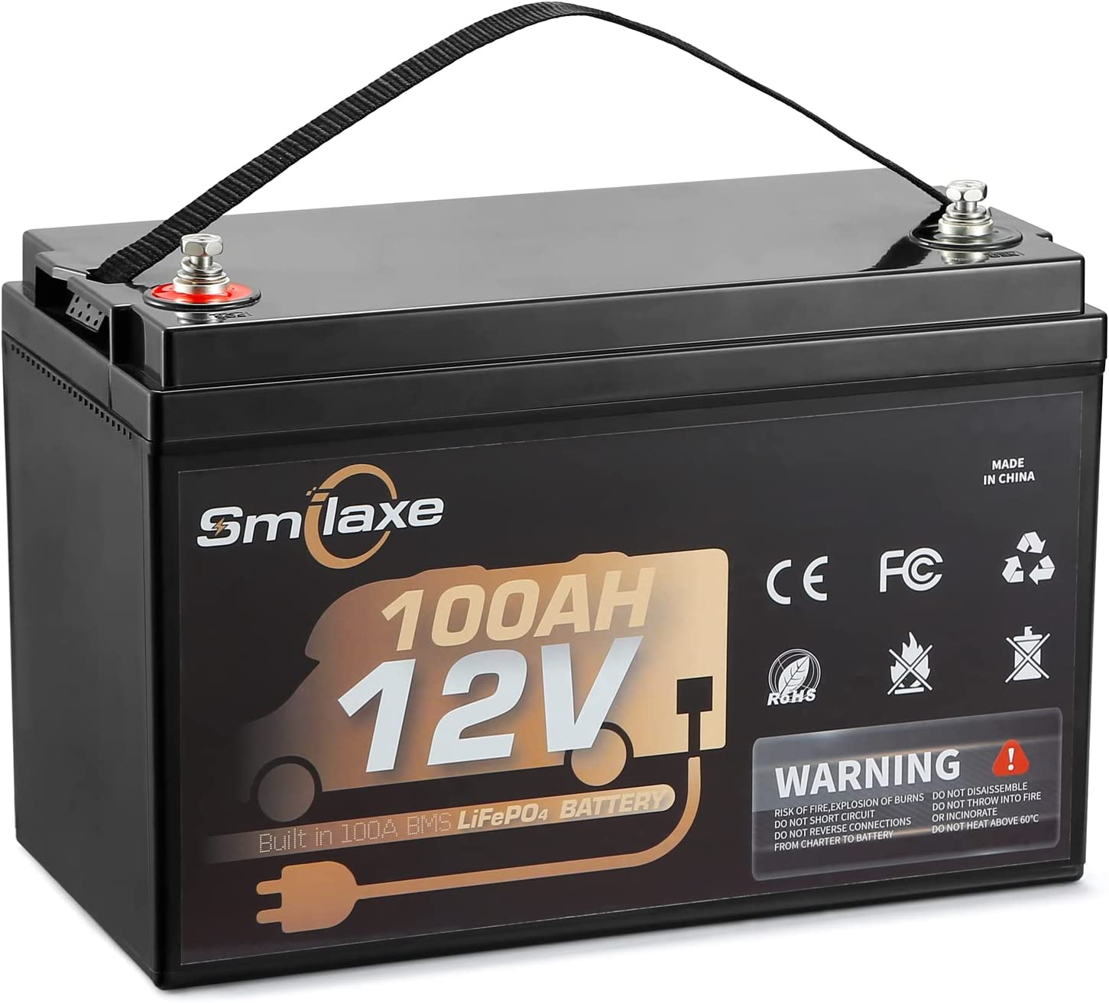
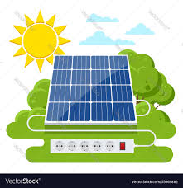
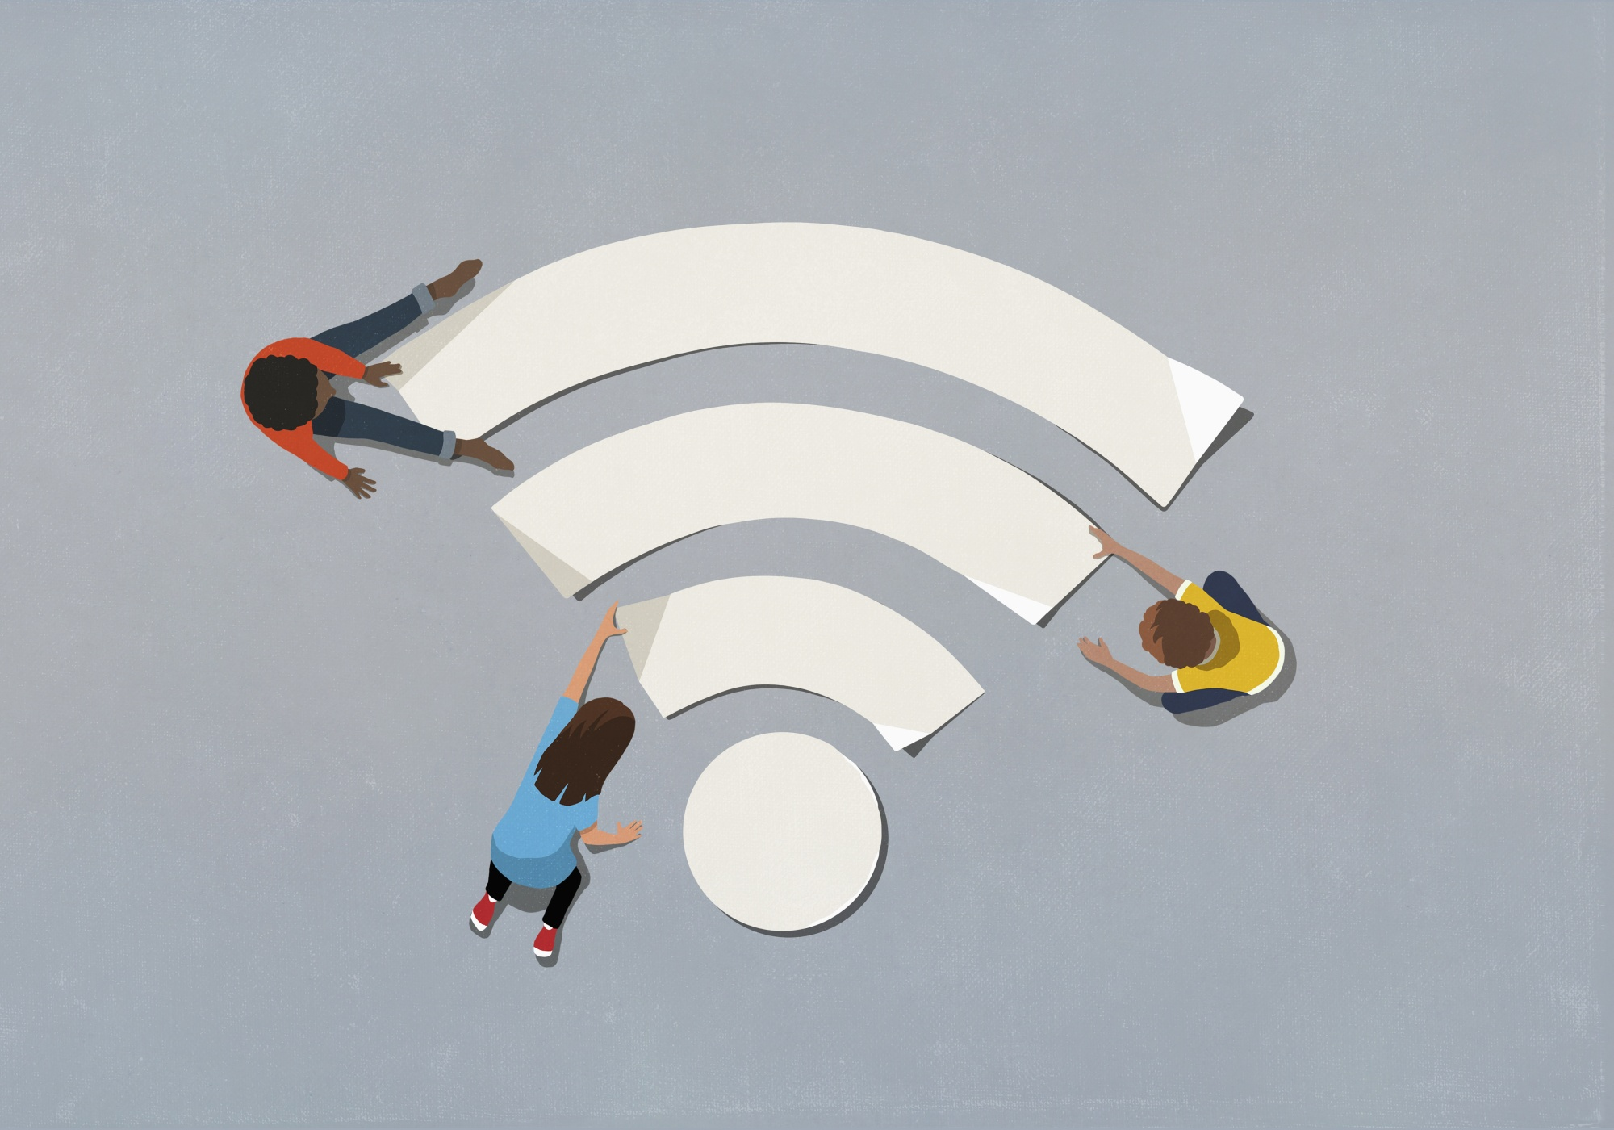
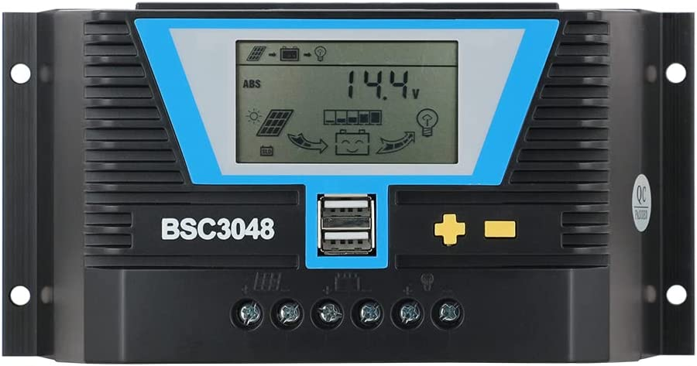
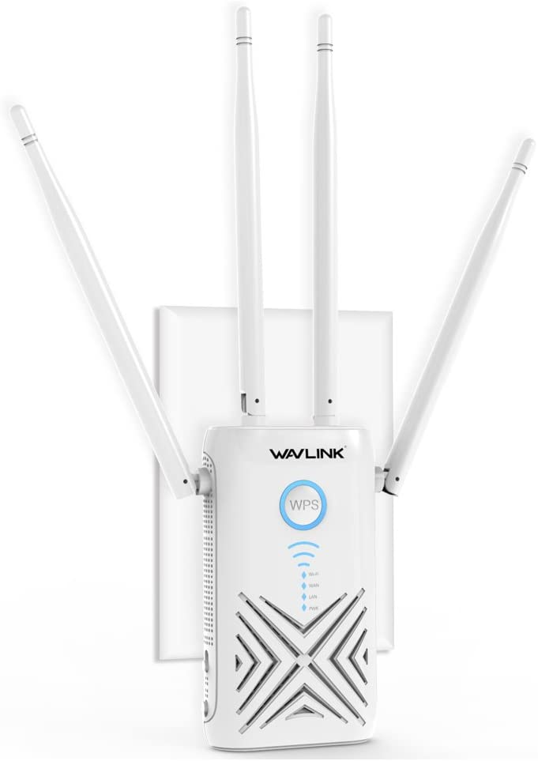
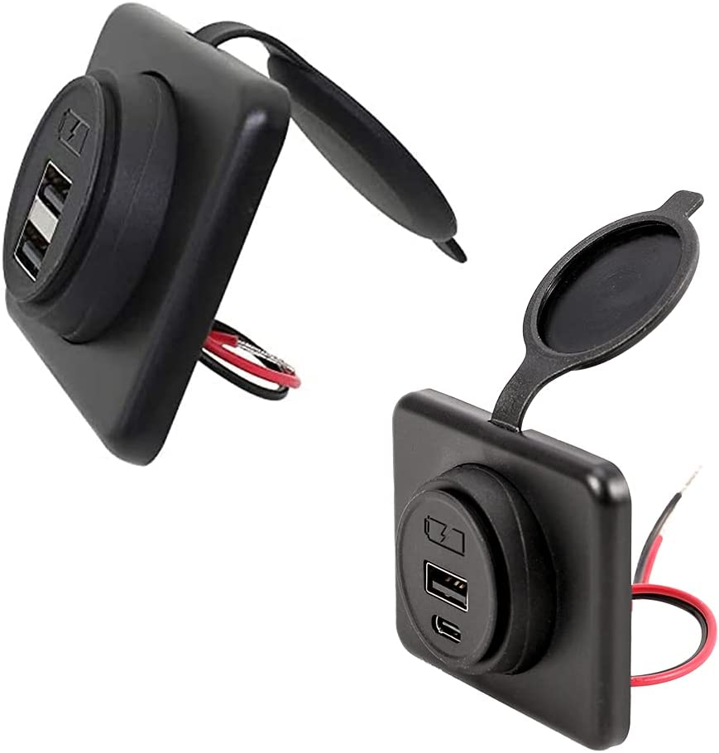
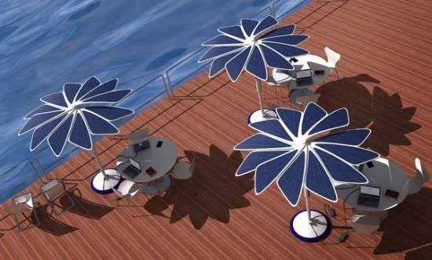

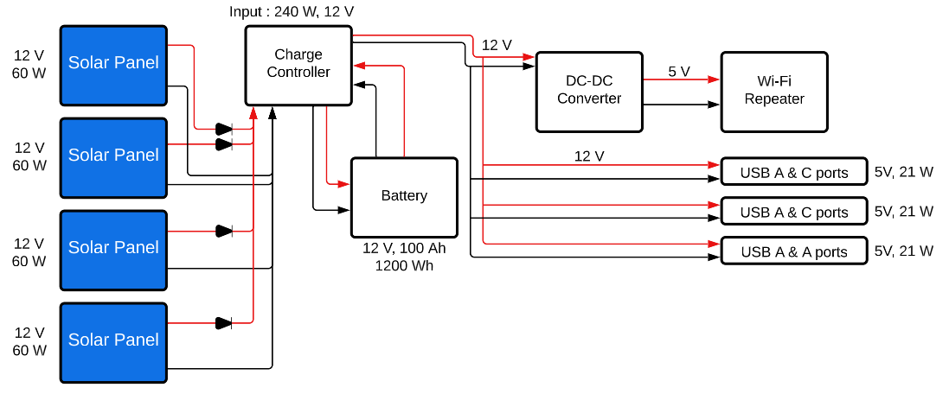
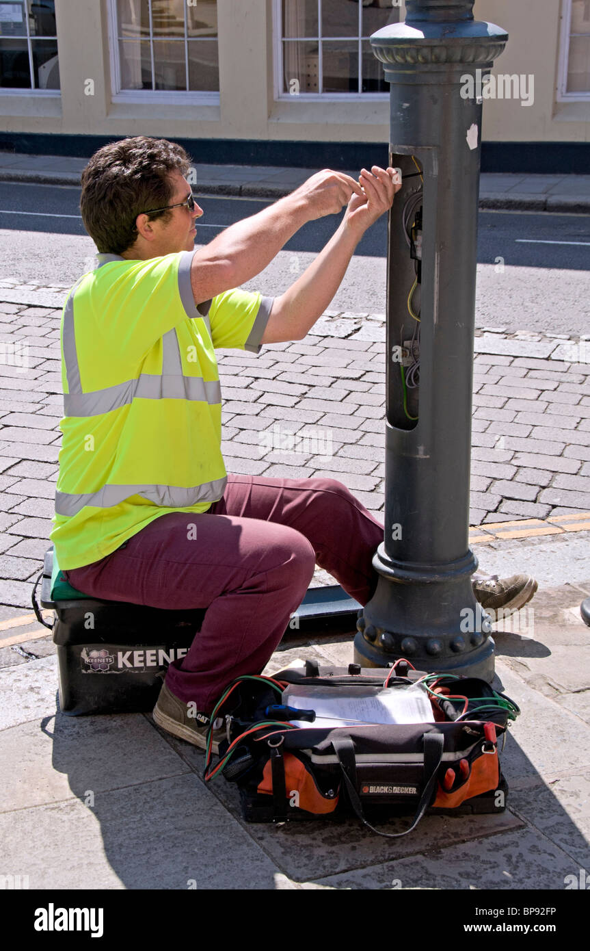

Digital Wi-Fi Canopy
Team 312: Angel Salges, Alana Brandt, Hetanshu Patel, Victor Perry
Dr. Shonda Bernadin, Dr. Hui Li
Abstract
Design
Component Breakdown
Digital Wi-Fi Canopy is a solar powered umbrella that will be placed at bus stops and parks which will have USB charging ports and Wi-Fi capability. The areas of focus for this project is the Providence neighborhood in Tallahassee, FL. The purpose of this project was to bridge the digital gap in areas that lack internet accessibility. The main requirements for this design are that it is solar powered, Wi-Fi capable, weather resistant, low maintenance, and accessible. Possible markets for this project are transportation companies, park managements, and local governments.
Solar Panels
Four Polycrystalline Solar Panels
Nominal Voltage: 12V
Current: 3.6A
Power: 60W
Parallel connection
Solar Charge Controller
Voltage: 12V
Current Max : 30A
Power Output: 15W
Battery
Type: Lithium Iron Phosphate Battery
Voltage: 12V
Current: 100Ah
Power: 1200Wh
DC-DC Converter
Input Voltage: 12V
Output Voltage: 5V
Current Output: 3A
Power Output: 15W
Wi-Fi Extender
Voltage: 5V
Current: 2.5A
Power: 12.5W
USB-A and USB-C Ports
Voltage: 12V
Current: 2.1A
Power: 25.2W
Main Goals
Use Solar Energy
Aesthetically Pleasing Shelters
Low Maintenance
Reduce the Digital Gap
Convenience for Users
Weather Resistant
Figure 1. Example Design
Figure 1 shows an example design that is used to base the final Wi-Fi canopy structure. The final design of the canopy will also include wifi extender.
Results & Future Work
We managed to make a reliable system to charge mobile devices using solar energy. The system can charge up to 6 devices simultaneously alongside powering a network device. We are facing challenges with the panels as we were not able to acquire the one listed but we are evaluating one with very similar characteristics. This can help us acquire more data and verify our design.
Future work can include building, testing a fully functional structure and possible upgrades. Building will involve making the structure and adjusting the circuit to fit the full-size umbrella. There is more research to be done on the materials or adjustments that can be used to improve the umbrella structure. Testing will include looking at the average charge rate during different climate conditions, structural integrity after climate events among others.Possible upgrades to the canopy could be changing the repeater to a mesh network, or amenities such as fans, lights, heaters or a display for bus timings.
Figure 2. Block Diagram
Notes:
Bi directional Battery
Power rating for Solar Charge Controller
Outlets inputs and outputs specifications
60 W for One panel or all panels
Peak power, rater power specify
Output power of solar charge controller needs to output more W then wifi and outlets combined
fix the component breakdown charge controller
how long does it take to charge battery

